Slide 1

Global Multiple Myeloma Academy – Day 2
Emerging and Practical Concepts
in Multiple Myeloma
18–19 March 2022
Sponsor

Slide 2
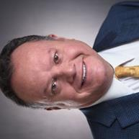
Session Open
Rafael Fonseca, MD

Slide 3





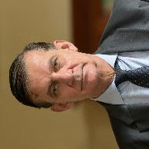

Faculty
Chair
Irene Ghobrial, MD
Dana-Farber Cancer Institute, USA
Keith Stewart, MBChB, MBA
Princess Margaret Cancer Centre, Canada
María-Victoria Mateos, MD, PhD
University of Salamanca, Spain
Xavier Leleu, MD, PhD
Hôpital La Miletrie, France
Rafael Fonseca, MD
Mayo Clinic Cancer Center, USA
Bruno Paiva, PharmD, PhD
University of Navarra, Spain
Meletios A. Dimopoulos, MD
University of Athens, Greece
Hermann Einsele, MD Universitätsklinikum Würzburg, Germany

Slide 4
Objectives of the Program
Share key data from recent conferences that could lead to improved treatment and management for patients with myeloma
Discuss early treatment strategies for smoldering myeloma and initial therapies for multiple myeloma
Provide insights into the evolving role of minimal residual disease (MRD) monitoring in the management of patients with multiple myeloma
Present the latest research on identifying multiple myeloma patients at high risk for early relapse, and management strategies for early relapse
Discuss the benefits and limitations of current options for treating patients with multiple myeloma refractory to multiple therapeutic modalities
Explore regional challenges in the treatment of multiple myeloma across Europe

Slide 5
Agenda Day 2 – Europe
17.00 – 20.00 (CET)/10.00 – 13.00 (MST)
Time | Topic | Speaker
17.00 – 17.10 | Session Open | Rafael Fonseca, MD
17.10 – 17.30 | Identification and Special Considerations for High-Risk Multiple Myeloma | Meletios A. Dimopoulos, MD
17.30 – 17.55 | Management of Early Relapse of Multiple Myeloma | Rafael Fonseca, MD
17.55 – 18.20 | Management of Heavily Pretreated Multiple Myeloma | Keith Stewart, MBChB, MBA
18.20 – 18.30 | Break
18.30 – 19.25 | Bispecifics in Multiple Myeloma and CAR Ts in Multiple Myeloma | María-Victoria Mateos, MD, PhD (bispecifics); Hermann Einsele, MD (CAR Ts)
19.25 – 19.55 | Patient Case Discussion: Relapsed/Refractory Multiple Myeloma Cases from 2 regions will be presented by Borja Puertas Martínez (University of Salamanca, Spain) and Despoina Fotiou (University of Athens, Greece) | Regional case presenter All faculty
19.55 – 20.00 | Session Close | Rafael Fonseca, MD

Slide 6
Question 1
?
What treatment belongs to the T-cell engagers category?
Melflufen
Belantamab
Ide-cel
Selinexor
Venetoclax
@rfonsi1, fonseca.rafael@mayo.edu

Slide 7
Question 2
?
Which of the following combinations has not been tested in phase III clinical trials in RR MM?
  Dara-Pd
  Elotuzumab, venetoclax, dexamethasone
  Bortezomib, pomalidomide, dexamethasone
  Bortezomib, daratumumab, dexamethasone
  Carfilzomib, lenalidomide, dexamethasone
@rfonsi1, fonseca.rafael@mayo.edu

Slide 8
Question 3
?
Which statements are true for the treatment of myeloma?
  There is a high rate of attrition (loss)
  Several drug trials show that 2 drugs can be as good as 3 in terms of efficacy
  Myeloma is a heterogeneous disease with increased rates of p53 abnormalities with progression
  All the above
  1 and 3
@rfonsi1, fonseca.rafael@mayo.edu

Slide 9

Identification and Special Considerations for High-Risk Multiple Myeloma
Meletios A. Dimopoulos, MD

Slide 10


Identification and Special Considerations for High-Risk Multiple Myeloma
Risk Stratification, Prognosis, and Treatment Choices
Meletios (Thanos) Dimopoulos, MD
Professor of Hematology/Oncology
Rector of the National and Kapodistrian University of Athens (NKUA)
Plasma Cell Dyscrasias Unit, Department of Clinical Therapeutics,
NKUA, School of Medicine, Athens, Greece

Slide 11
Disclosures: Meletios A. Dimopoulos
Name of Company | Advisory Board | Honoraria
Amgen | X | X
Janssen | X | X
Celgene/Genesis | X | X
Sanofi |  | X
Takeda | X | X
BMS | X | X
GSK | X | X

Slide 12
Question 1: When you treat your patient, which of the following risk parameters do you take into consideration?
?
  I evaluate high-risk cytogenetics according to R-ISS
  I evaluate high-risk cytogenetics according to R-ISS plus abnormalities of 1q (gain/amplification)
  I do not have a FISH facility in my center/country for the evaluation of high-risk cytogenetics
  I do not need any high-risk cytogenetic results; I treat all patients similarly

Slide 13
Question 2: What is your standard of care for high-risk cytogenetic patients who are eligible for ASCT?
?
  VCD plus ASCT plus lenalidomide maintenance
  DaraVTD plus ASCT plus lenalidomide maintenance
  Bortezomib-based induction plus 2 planned ASCT plus lenalidomide and bortezomib (once per week) maintenance
  Bortezomib-based induction plus 2 planned ASCT plus lenalidomide only maintenance

Slide 14
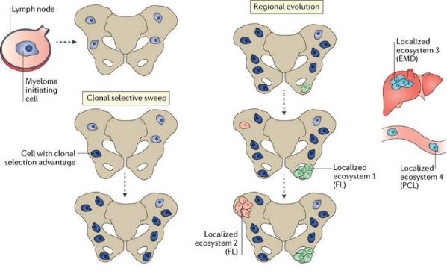
Myeloma Is Not Only 1 Disease:
Several Factors Determine Prognosis
Clonal Heterogeneity
Patient-Specific Factors
Age
Comorbidities, eg, renal failure, cardiac failure
Frailty
Disease-Specific Factors
ISS stage
Adverse cytogenetics
High LDH
High circulating PC (PCL)
Extramedullary disease
Response to therapy
ISS: International Staging System
ISS, international staging system; LDH, lactate dehydrogenase; MRD, minimal residual disease; PCL, plasma cell leukemia.

Slide 15
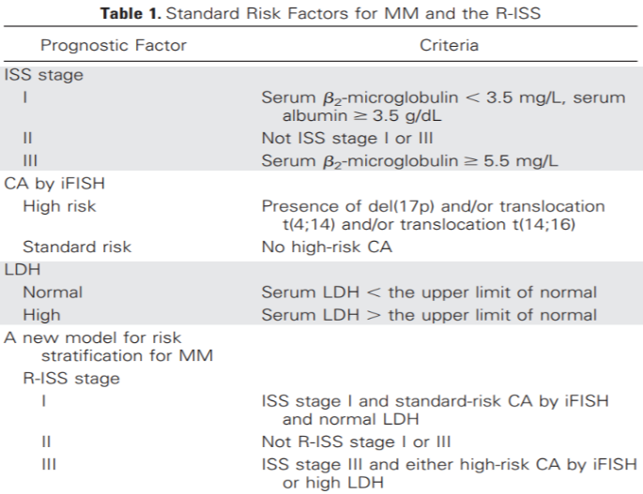
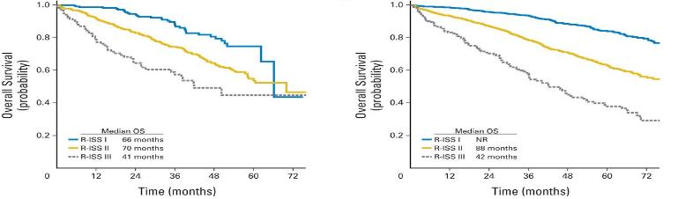
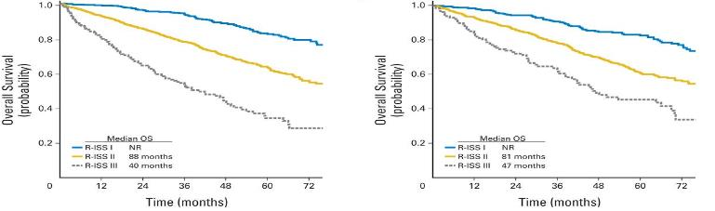
Revised International Staging System
Non–transplantation-based regimens
Transplantation-based regimens
Immunomodulatory-based regimens
Proteasome inhibitor-based regimens
Palumbo A, et al. J Clin Oncol. 2015;33(26):2863-2869.

Slide 16
RISS: Relapsed Disease
Tandon N, et al. Blood Cancer J. 2017;7(2):e528.

Slide 17
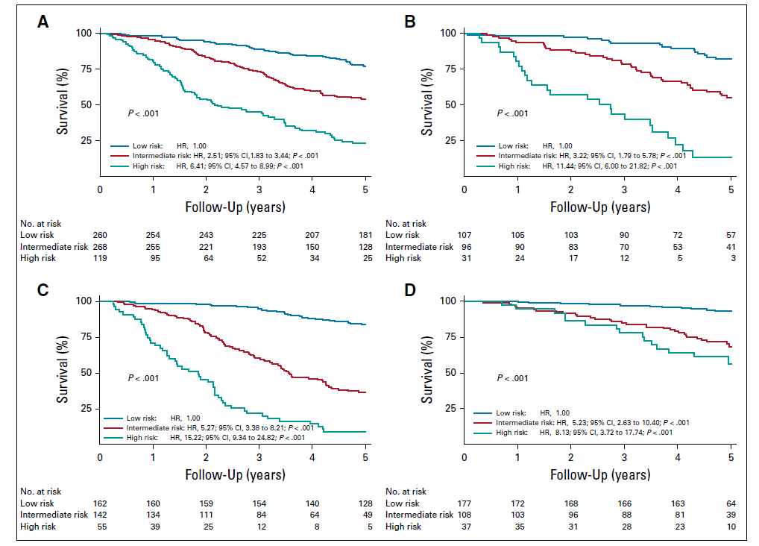
Adverse Cytogenetics: Novel Scoring
Training set (n = 647)
Del(17p); t(4;14); del(1p32); 1q21 gain; and trisomies 3, 5, and 21
Internal validation set (n = 234)
The low-risk group included all patients with a PI ≤0 in whom 5-year survival probability was >75%
The high-risk group included all patients with a PI >1 in whom 5-year survival probability was <50%
The intermediate-risk group included patients with a PI of 0 to 1 in whom 5-year survival probability was 50%–75%
PI was computed as follows:
0.4 × t(4;14) + 1.2 × del(17p) − 0.3 × trisomy 5 + 0.3 × trisomy 21 + 0.5 × 1q gain + 0.8 × del(1p32)
External validation data set 1 (n = 359) External validation data set 2 (n = 322)
Perrot et al. J Clin Oncol. 2019;37(19):1657-1665.

Slide 18
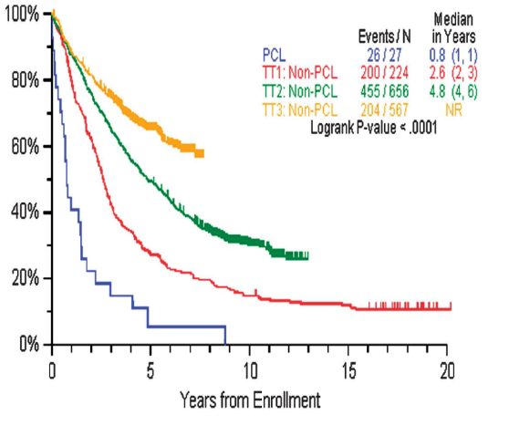
Plasma Cell Leukemia
Arkansas Experience (27 patients enrolled in TTP)
PFS
OS
→ PFS: 0.8 years, OS: 1.8 years (different from MM, has not improved over time)
Usmani SZ, et al. Leukemia. 2012;26(11):2398-2405.

Slide 19
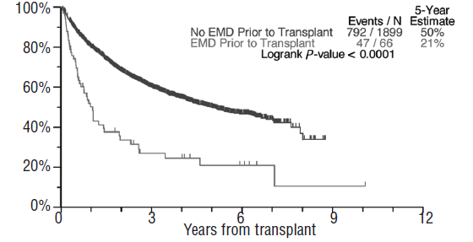
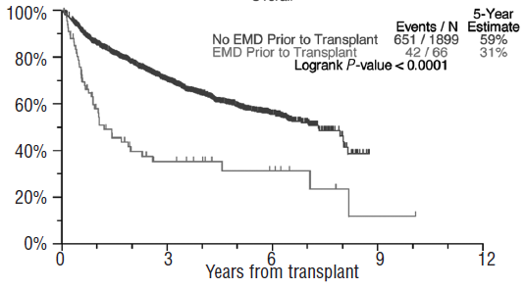
Extramedullary Disease
Arkansas Experience
Event-Free Survival
Overall Survival
Usmani SZ, et al. Haematologica. 2012;97(11):1761-1767.

Slide 20
A High-Risk, Double-Hit Group of Newly Diagnosed Myeloma Identified by Genomic Analysis
Comparison of IMWG and double-hit cases. A. Patients were classified by IMWG status and recursive partitioning risk groups. Double-hit patients have very poor PFS, whether classified as high risk by IMWG (median PFS 11 months, 18-month PFS of 35%) or low/intermediate risk by IMWG (median PFS 16 months, 18-month PFS of 44%). B. Similar trends were observed for OS classified by both IMWG and recursive partitioning status.
Walker B, et al. Leukemia. 2019;33(1):159-170.
Notes:
More recently, as part of the MGP led by Gareth Morgan and Nikhil Munshi, defined the DNA drivers of aggressive clinical behavior. A high-risk subgroup was defined by recursive partitioning using either a) bi-allelic TP53 inactivation or b) amplification (≥4 copies) of CKS1B (1q21) on the background of International Staging System III,
comprising 6.1% of the population (median PFS = 15.4 months; OS = 20.7 months)

Slide 21
Prognostic Impact of Early Relapse
Kumar S, et al. Leukemia 2018;32:986-995; Majithia N, et al. Leukemia 2016;30:2208-2213.

Slide 22
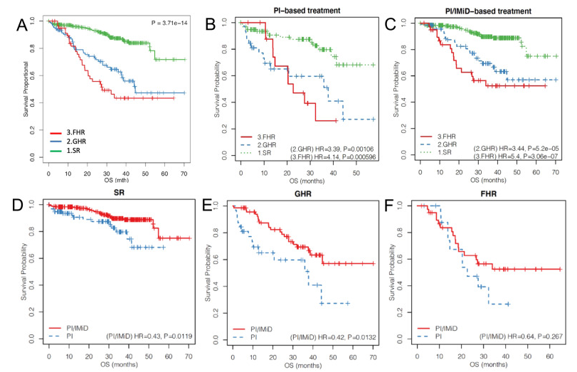
Prognostic Impact of Combined Genomics and
Response to Therapy
512 patients into 3 groups
Genomic high-risk (GHR) group for patients with t(4;14) or t(14;16) or complete loss of functional TP53 (biallelic deletion of TP53 or monoallelic deletion of 17p13 [del(17p13)] and TP53 mutation) or 1q21 gain and ISS stage 3
FHR group for patients who had no markers of GHR but were refractory to induction therapy or had early relapse within 12 months
Standard-risk (SR) group for patients who did not fulfill any of the criteria for GHR or FHR
Soekojo CY, et al. Blood Cancer J. 2022;12(1):24.

Slide 23
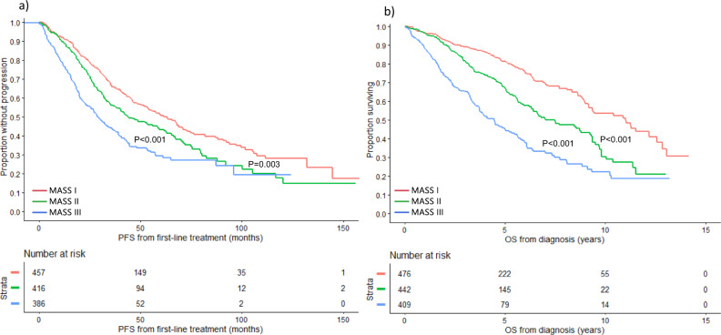
Mayo Additive Staging System (MASS)
No HR factors (stage I; red curve), 1 HR factor (stage II; green curve), and ≥2 HR factors (stage III; blue curve).
HR factors are defined as any of: HR IgH translocations, 1q gain/amplification, chromosome 17 abnormality (del[17p]/monosomy 17), ISS stage III, and LDH > ULN.
Abdallah NH, et al. Blood Cancer J. 2022;12(1):21.

Slide 24
Management of High-Risk Myeloma in NDMM Who Are Eligible for ASCT

Slide 25
Frontline Therapy With Double ASCT VMP vs ASCT EMN02/HO95 Study
4 × VCD +
Stem cell apheresis
Single ASCT policy
Randomization 1:1
Double ASCT policy
Randomization 1:1:1
R1
4 × VMP
(N = 497)
HDT Mel 200
(N = 695)
VMP
(294 pts)
VMP
(203 pts)
R2
2 × VRD
(N = 462)
No consolidation
(N = 454)
ASCT-1
(280 pts)
ASCT-1
(208 pts)
Len maint
Len maint
HDM/ASCT at first relapse
PRIMARY
PFS from R1: ASCT vs VMP
PFS from R2: VRD consolidation vs no consolidation
SECONDARY
PFS from R1: HDM-1 vs HDM-2
ASCT-2
(207 pts)
Cavo M, et al. Lancet Haematol. 2020;7(6):e456-e468.
Notes:
How about the role of transplant?
EMN02 randomized 1499 patients to this trial. 1192 pts are included in the analysis. 2 randomizations

Slide 26
OS by Randomization in High-Risk Subgroups:
ASCT Advantage
Del(17p) and/or t(4;14) and/or t(14;16)
Del(17p) positivity
R-ISS III
0.60
Cavo M, et al. Lancet Haematol. 2020;7(6):e456-e468.

Slide 27
OS in High-Risk Subgroup: Double vs Single ASCT
High-risk cytogenetics
R-ISS II + III
Cavo M, et al. Lancet Haematol. 2020;7(6):e456-e468.

Slide 28
CASSIOPEIA: Study Design
Open-label, global, multicenter, randomized phase III trial
Primary endpoint (part 2): PFS (after second randomization)
Key secondary endpoints (part 2): TTP (after second randomization), rates of ≥CR, MRD negativity rates (in ≥CR at a threshold of 10⁻⁵ by NGS), OS
Maintenance
Stratified by induction treatment (D-VTd vs VTd), depth of response
Dara Q8W until PD
(max of 2 yr followed by observation until PD)
Patients aged
18–65 yr with transplant-eligible newly diagnosed MM, ECOG PS 0–2
(N = 1085)
Patients with ≥PR after completion of part 1 treatment
(N = 886)
Daratumumab + VTd
4 cycles
ASCT
Daratumumab + VTd
2 cycles
VTd
4 cycles
ASCT
VTd
2 cycles
Observation until PD
(maximum of 2 yr)
Part 1
Part 2
Moreau P, et al. ASCO 2021. Abstract 8004.

Slide 29
CASSIOPEIA Part 2: PFS by Subgroups
Hazard Ratio (95% Cl)
Hazard Ratio (95% Cl)
Sex
Male
Female
Pre-maintenance baseline renal function
CrCl >90 mL/min
CrCl ≤90 mL/min
0.57 (0.42-0.76)
0.53 (0.35-0.81)
0.51 (0.38-0.68)
0.72 (0.47-1.12)
Age
<50 years
50-60 years
>60 years
Type of MM
IgG
Non-IgG
0.38 (0.20-0.74)
0.56 (0.39-0.79)
0.67 (0.46-0.98)
0.64 (0.48-0.87)
0.44 (0.26-0.75)
Premaintenance baseline ECOG PS
0
≥1
Site
IFM
HOVON
0.55 (0.40-0.76)
0.57 (0.40-0.82)
0.56 (0.43-0.72)
0.59 (0.31-1.13)
Induction/ASCT/consolidation tx group
VTd
D-VTd
0.34 (0.24-0.47)
1.05 (0.73-1.51)
ISS Staging
I
II
III
0.50 (0.32-0.78)
0.56 (0.40-0.79)
0.75 (0.44-1.29)
MRD
Positive
Negative
0.46 (0.31-0.67)
0.61 (0.44-0.83)
Cytogenetic risk
High risk
Standard risk
Response
VGPR or better
PR
0.43 (0.25-0.73)
0.62 (0.48-0.82)
0.58 (0.45-0.75)
0.39 (0.21-0.73)
0.1
1
0.1
1
Favors DARA
Favors OBS
Favors DARA
Favors OBS
Moreau P, et al. ASCO 2021. Abstract 8004.

Slide 30
FORTE Efficacy by Cytogenetic Risk: Study Design
Multicenter, randomized, open-label phase II study
Induction
4 × 28-day cycles
Consolidation
4 × 28-day cycles
Arm A: KCd
(n = 159)
Arm A: KCd
(n = 159)
Single
ASCT
R
Patients with NDMM, eligible for ASCT and <65 yr of age
(N = 474)
Arm B: KRd
(n = 158)
Mobilization
Arm B: KRd
(n = 158)
Second randomization
4 × 28-day cycles
Arm C: KRd
(n = 157)
Arm C:
KRd
Arm C: KRd
(n = 157)
KR
Dosing in slide notes.
Endpoint 1:
postinduction VGPR
Endpoint 2:
premaintenance VGPR, sCR, MRD negativity, safety, rate of early relapse
Gay F, et al. ASCO 2021. Abstract 8002.

Slide 31
FORTE Efficacy by Cytogenetic Risk:
PFS Following First Randomization
Median follow-up after first randomization: 51 mo (IQR: 46-55)
4-yr PFS, % | KCd-ASCT (n = 138) | KRd-ASCT (n = 132) | KRd12 (n = 126) | HR (95% CI) KRd-ASCT vs KCd-ASCT | HR (95% CI) KRd-ASCT vs KRd12 | HR (95% CI) KRd12 vs KCd-ASCT
Overall | 51 | 69 | 56 | 0.54 (0.38-0.78; P <.001) | 0.61 (0.43-0.88; P = .0084) | 0.88 (0.64-1.22; P = .45)
FISH status Standard risk High risk Double hit | 62 45 33 | 82 62 55 | 67 45 31 | 0.44 (P = .04) 0.57 (P = .01) 0.49 (P = .03) | 0.46 (P = .04) 0.6 (P = .04) 0.53 (P = .07) | 0.96 (P = .9) 0.95 (P = .8) 0.91 (P = .75)
Chromosomal abnormalities (FISH) Del(17p) Del(1p) Gain(1q) t(4;14) Amp(1q) | 43 41 38 43 32 | 52 82 71 50 33 | 40 72 45 29 18 | 0.57 (P = .185) 0.24 (P = .06) 0.35 (P = .001) 0.73 (P = .44) 1.16 (P = .72) | 0.61 (P = .28) 0.73 (P = .72) 0.45 (P = .02) 0.59 (P = .19) 0.87 (P = .73) | 0.94 (P = .89) 0.33 (P = .09) 0.78 (P = .38) 1.23 (P = .57) 1.34 (P = .46)
Gay F, et al. ASCO 2021. Abstract 8002.
Notes:
ASCT, autologous stem cell transplantation; FISH, fluorescence in situ hybridization; IQR, interquartile range; KCd, carfilzomib/cyclophosphamide/dexamethasone; KRd, carfilzomib/lenalidomide/dexamethasone; KRd12, 12 cycles of carfilzomib/lenalidomide/dexamethasone; PFS, progression-free survival.

Slide 32
FORTE Efficacy by Cytogenetic Risk:
PFS Following Second Randomization
Median follow-up after second randomization: 37 mo (IQR: 33-42)
3-yr PFS, % | KR (n = 140) | R (n = 152) | HR (95% CI) KR vs R
Overall | 75 | 65 | 0.64 (0.44-0.94; P = .02294)
FISH status Standard risk High risk Double hit | 90 69 67 | 73 56 42 | 0.40 (P = .05) 0.60 (P = .04) 0.53 (P = .1)
Chromosomal abnormalities (FISH) Del(17p) Del(1p) Gain(1q) t(4;14) Amp(1q) | 60 86 72 71 46 | 57 57 53 53 45 | 0.59 (P = .38) 0.23 (P = .07) 0.54 (P = .07) 0.59 (P = .31) 0.83 (P = .72)
Gay F, et al. ASCO 2021. Abstract 8002.
Notes:
FISH, fluorescence in situ hybridization; IQR, interquartile range; KR, carfilzomib/lenalidomide; R, lenalidomide.

Slide 33
Treatment According to Mayo Risk-Stratification System

Slide 34
Treatment of High-Risk Disease in Myeloma Patients Who Are NOT Eligible for ASCT

Slide 35
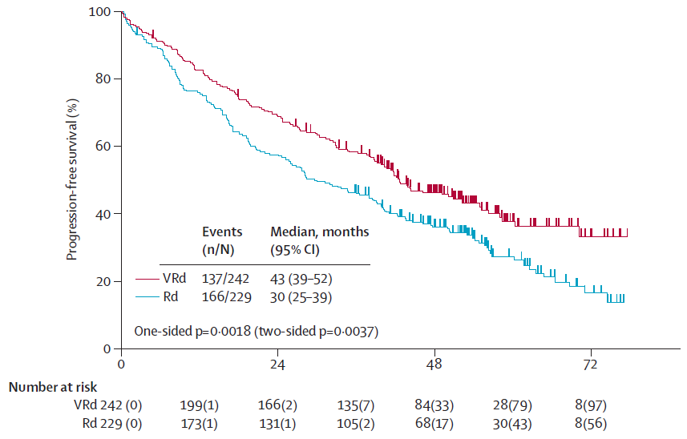
VRd vs Rd, by FISH
Median progression-free survival, by therapy
 | RVd | Rd
Overall (N = 471) | 43 months | 30 months
High-risk FISH (N = 44) | 38 months | 16 months
Durie BGM, et al. Lancet 2016;389:519-527.

Slide 36
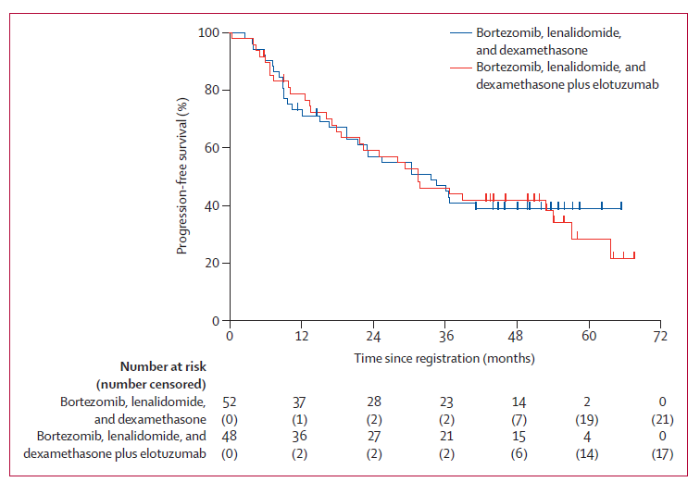
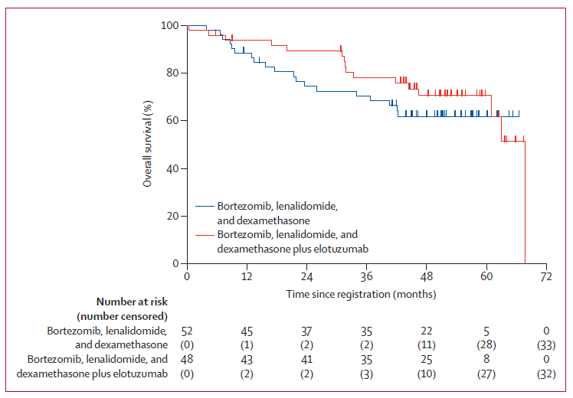
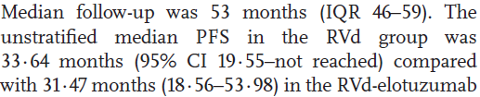
Survival in High-Risk Patients: VRD vs VRD + Elo
High-risk myeloma was defined by one of the following: gene expression profiling high-risk (GEP^{hi}), t(14;16), t(14;20), del(17p), or amp1q21, primary plasma cell leukemia and elevated serum lactate dehydrogenase (2× the upper limit of normal or more).
Elo-VRD: 68 months
VRD: not reached
Usmani SZ, et al. Lancet Haematol. 2021;8(1):e45-e54.

Slide 37
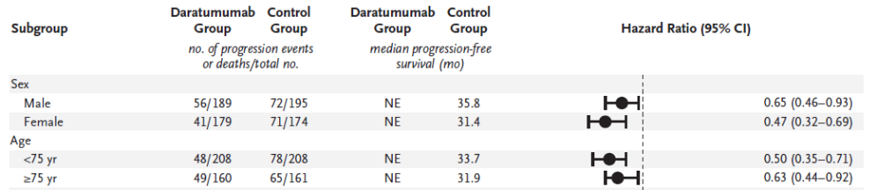
MAIA: DRd vs Rd, PFS by FISH
Progression events or deaths, by therapy
 | DRd | Rd
Standard risk (N = 550) | 67/271 (25%) | 111/279 (40%)
High-risk FISH (N = 92) | 18/48 (38%) | 17/44 (39%)
Facon T, et al. N Engl J Med. 2019;380:2104-2115.

Slide 38
Impact of Daratumumab in the Treatment of High-Risk NDMM
Pooled analysis of 3 NDMM trials (ALCYONE, MAIA, CASSIOPEIA)
The addition of D to backbone MM regimens led to improved PFS among patients with HRMM,* both NDMM (pooled HR 0.67; 95% CI: 0.47–0.95, P = .02)
Study or subgroup | Log[HR] | SE | Daratumumab Total | Control Total | Weight | HR IV, random, 95% CI | HR IV, random, 95% CI
Newly diagnosed HRMM
MAIA | -0.5621 | 0.301 | 48 | 44 | 35.6% | 0.57 (0.32–1.03)
CASSIOPEIA | -0.4005 | 0.3313 | 82 | 86 | 29.4% | 0.67 (0.35–1.28)
ALCYONE | -0.2485 | 0.3038 | 53 | 45 | 35.0% | 0.78 (0.43–1.41)
Subtotal (95% CI) |  |  | 183 | 175 | 100% | 0.67 (0.47–0.95)
Heterogeneity: Tau² = 0.00; Chi² = 0.54, df = 2 (P = 0.76); I² = 0%
Test for overall effect: Z = 2.25 (P = 0.02)
0.002
0.1
1
10
500
Favors daratumumab
Favors control
Giri S, et al. EHA 2020. EP952 (ePoster).
*High-risk cytogenetics defined as presence of t(4;14), t(14;16), or del(17p).
D, daratumumab; df, degrees of freedom; HR, hazard ratio; HRMM, high-risk multiple myeloma; IV, instrumental variables; MM, multiple myeloma; NDMM, newly diagnosed multiple myeloma; PFS, progression-free survival; RRMM, relapsed/refractory multiple myeloma; SE, standard error.

Slide 39
Treatment According to Mayo Risk-Stratification System

Slide 40
Summary
At diagnosis, all patients should be tested by FISH for del(17p), t(4;14), t(14;16), add1q, and t(11;14)
In cases of high-risk cytogenetics, treatment for ASCT-eligible patients includes VRD induction, double ASCT, and VR maintenance; addition of daratumumab might improve PFS in this setting, but this has to be shown in larger patient numbers
For ASCT-ineligible patients, treatment includes VRD or VRD-lite; DaraRd does not seem to be optimal for these patients. Do we need bortezomib-based maintenance?

Slide 41
Question 1: When you treat your patient, which of the following risk parameters do you take into consideration?
?
  I evaluate high-risk cytogenetics according to R-ISS
  I evaluate high-risk cytogenetics according to R-ISS plus abnormalities of 1q (gain/amplification)
  I do not have a FISH facility in my center/country for the evaluation of high-risk cytogenetics
  I do not need any high-risk cytogenetic results; I treat all patients similarly

Slide 42
Question 2: What is your standard of care for high-risk cytogenetic patients who are eligible for ASCT?
?
  VCD plus ASCT plus lenalidomide maintenance
  DaraVTD plus ASCT plus lenalidomide maintenance
  Bortezomib-based induction plus 2 planned ASCT plus lenalidomide and bortezomib (once per week) maintenance
  Bortezomib-based induction plus 2 planned ASCT plus lenalidomide only maintenance

Slide 43

THANK YOU

Slide 44
Discussion

Slide 45
Management of Early Relapse of Multiple Myeloma
Rafael Fonseca, MD

Slide 46
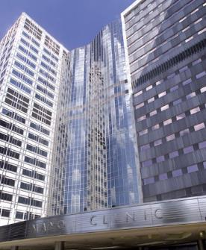
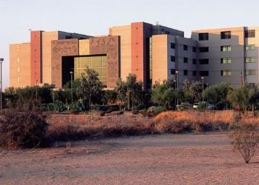
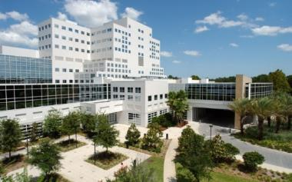

Rafael Fonseca, MD
Chief Innovation Officer
Mayo Clinic in Arizona
Multiple Myeloma – Treatment of Early Relapse
^{Phoenix, Arizona}
^{Rochester, Minnesota}
^{Jacksonville, Florida}
Mayo Clinic College of Medicine
Mayo Clinic Comprehensive Cancer Center
Notes:
Pruebas convencionales y moleculares para diagnóstico, pronóstico y seguimiento de los pacientes con Mieloma Múltiple
40 minutos

Slide 47
Disclosures – Industry Relationships
Consulting: AMGEN, BMS, Celgene, Takeda, Bayer, Janssen, AbbVie, Pharmacyclics, Merck, Sanofi, Kite
SAB: Adaptive Biotechnologies, Caris Life Sciences (stock options)
Patent for FISH in MM: ~$2000/year
Registered independent
Believes in stem cell transplant

Slide 48
Multiple Myeloma Treatment Lines 2021
100 months
8 months 53 months 36 months
Front-line treatment
Maintenance
Relapsed
Induction
Consolidation
Maintenance
Rescue
Fonseca, unpublished.
Notes:
48

Slide 49
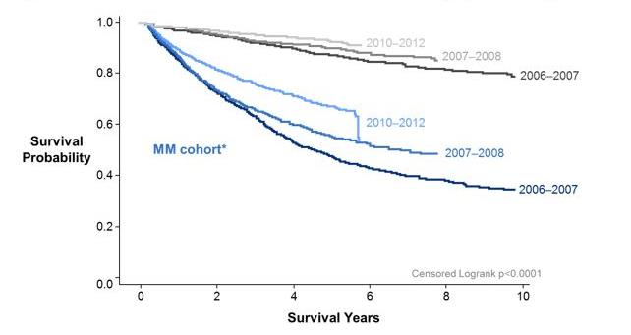
Improvements in Survival
Fonseca R, et al. Leukemia. 2017;31:1915-1921.

Slide 50
Attrition With Subsequent Treatment
1st -
2nd 57%
3rd 46%
4th 43%
5th 43%
1st –
2nd 21%
3rd 31%
4th 37%
5th 35%
Nontransplant
Transplant
Fonseca R, et al. BMC Cancer. 2020;20:1087.

Slide 51
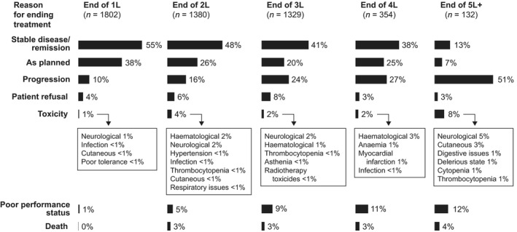
High Rate of Attrition
Remaining 61% 38% 15% 1%
Figure adapted from: Yong K, et al. Br J Haematol 2016;175:252-264.

Slide 52
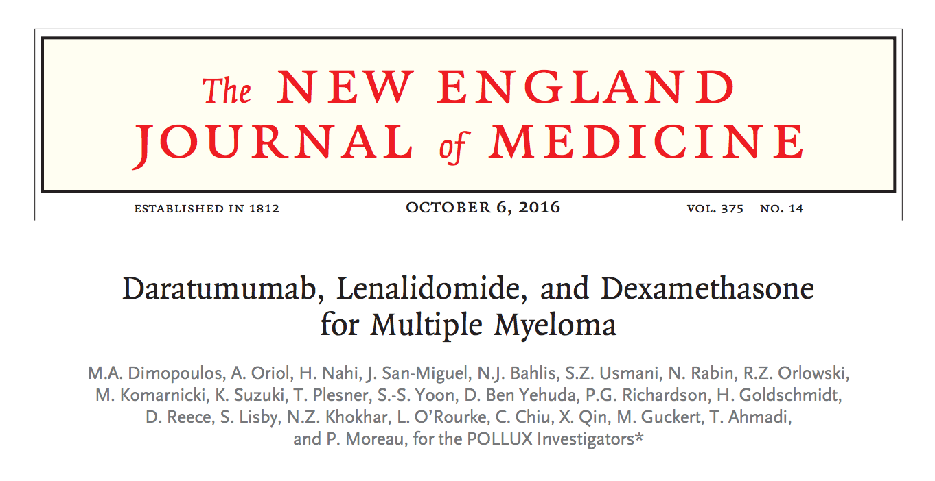
POLLUX Study
Dimopoulos MA, et al. N Engl J Med. 2016;375:1319-1331.

Slide 53
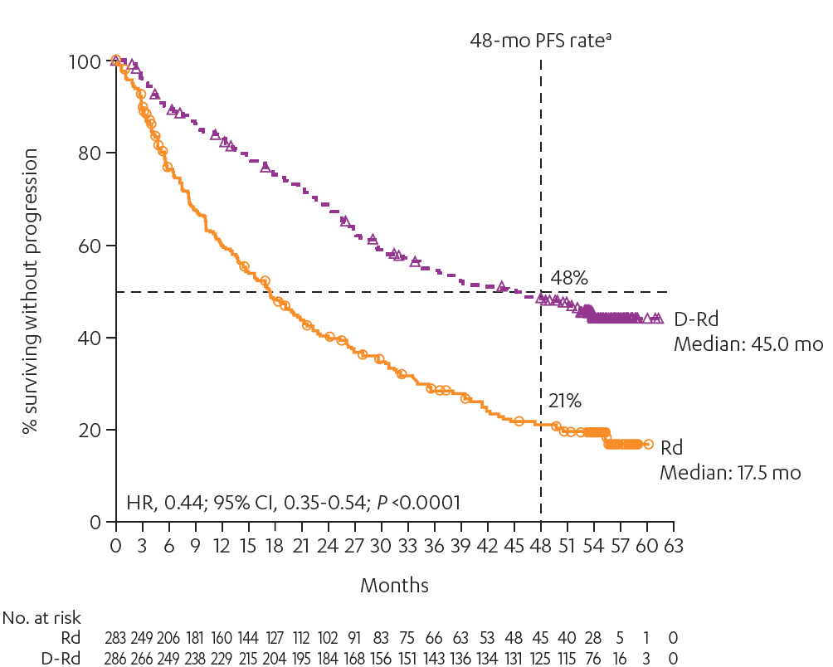
PFSª
Median follow-up: 54.8 months
DRd continued to demonstrate a significant PFS benefit with extended follow-up
ªKaplan-Meier estimate, intention-to-treat population.
DRd, daratumumab plus lenalidomide-dexamethasone; Rd, lenalidomide-dexamethasone; PFS, progression-free survival; HR, hazard ratio.
Dimopoulos MA, et al. N Engl J Med. 2016;375:1319-1331.

Slide 54
ORR
Median follow-up: 54.8 months
P <.0001
ORR = 93%
ORR = 76%
≥CR:
58%
≥CR:
24%
≥VGPR:
81%
≥VGPR:
49%
sCR
CR
VGPR
PR
Deeper responses were observed with DRd
DVd, daratumumab plus bortezomib-dexamethasone; Vd, bortezomib-dexamethasone; ORR, overall response rate; PR, partial response; VGPR, very good partial response; CR, complete response; sCR, stringent complete response.
Dimopoulos MA, et al. N Engl J Med. 2016;375:1319-1331.

Slide 55
MRD Negativity (10-5, NGS)
Median follow-up: 54.8 months
MRD negativity rate
Sustained MRD negativity rate
P <.0001
4.7-fold increase
Improved and sustained MRD negativity rates with DRd vs Rd
DRd, daratumumab plus lenalidomide-dexamethasone; Rd, lenalidomide-dexamethasone; MRD, minimal residual disease; NGS, next-generation sequencing.
Dimopoulos MA, et al. N Engl J Med. 2016;375:1319-1331.

Slide 56
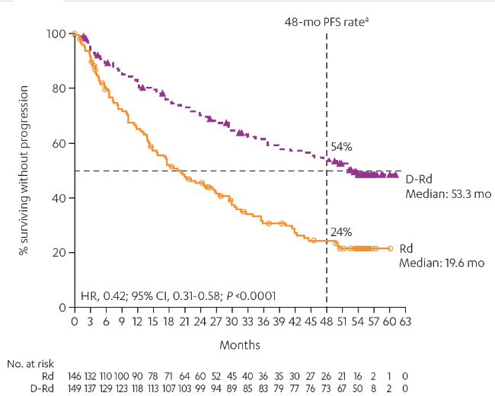
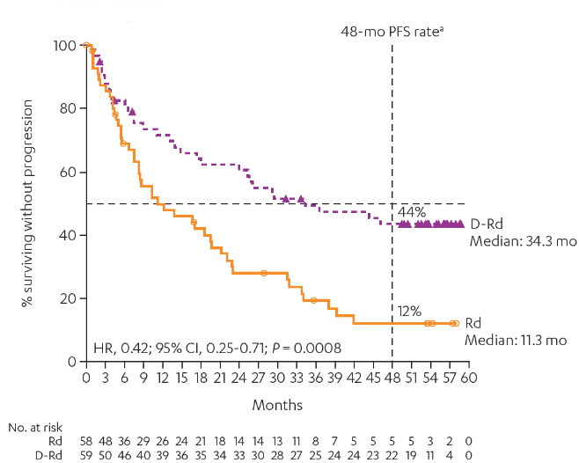
PFS in Subgroups
Median follow-up: 54.8 months
1 prior line of therapy
Refractory to bortezomib
Greatest benefit of DRd was seen in patients with 1 prior line of therapy
DRd, daratumumab plus lenalidomide-dexamethasone; Rd, lenalidomide-dexamethasone; PFS, progression-free survival; HR, hazard ratio.
Dimopoulos MA, et al. N Engl J Med. 2016;375:1319-1331.

Slide 57
Demographic and Baseline Disease Characteristics
 | DRd (n = 286) | Rd (n = 283)
Age, years
Median (range) | 65 (34–89) | 65 (42–87)
≥75, n (%) | 29 (10) | 35 (12)
ISS staging, n (%)ª
I | 137 (48) | 140 (50)
II | 93 (33) | 86 (30)
III | 56 (20) | 57 (20)
Time from diagnosis, years
Median (range) | 3.5 (0.4–27.0) | 4.0 (0.4–21.7)
Cytogenetic profile,^{b} n (%)
N | 228 | 211
Standard risk | 193 (85) | 176 (83)
High risk | 35 (15) | 35 (17)
 | DRd (n = 286) | Rd (n = 283)
Prior lines of therapy
Median (range) | 1 (1–11) | 1 (1–8)
1, n (%) | 149 (52) | 146 (52)
2, n (%) | 85 (30) | 80 (28)
3, n (%) | 38 (13) | 38 (13)
>3, n (%) | 14 (5) | 19 (7)
Prior ASCT, n (%) | 180 (63) | 180 (64)
Prior PI, n (%) | 245 (86) | 242 (86)
Bortezomib | 241 (84) | 238 (84)
Prior IMiD, n (%) | 158 (55) | 156 (55)
Lenalidomide | 50 (18) | 50 (18)
Prior PI + IMiD, n (%) | 125 (44) | 125 (44)
Refractory to bortezomib, n (%) | 59 (21) | 58 (21)
Refractory to last line of therapy, n (%) | 80 (28) | 76 (27)
ªISS staging was based on the combination of serum B2-microglobulin and albumin; ^{b}Cytogenetic risk status was established by FISH/karyotyping. Patients with high cytogenetic risk had a t(4;14), t(14;16). and/or del(17p) abnormality. Patients with standard cytogenetic risk had an absence of high cytogenetic risk abnormalities.
ITT, intent-to-treat; DRd, daratumumab plus lenalidomide-dexamethasone; Rd, lenalidomide-dexamethasone; ISS, International Staging System; ASCT, autologous stem cell transplant; PI, proteasome inhibitor, IMiD, immunomodulatory drug; FISH, fluorescence in situ hybridization.
Dimopoulos MA, et al. N Engl J Med. 2016;375:1319-1331.

Slide 58
APOLLO: Dara-Pd
Key eligibility criteria
RRMM
≥1 prior line with both lenalidomide and a PI
ECOG PS ≤2
CrCl ≥30 mL/min
D-Pd
D: 1,800 mg SC QW cycles 1–2,
Q2W cycles 3–6, Q4W cycles 7+
P: 4 mg PO days 1–21
d: 40 mg PO days 1, 8, 15, 22
Post-treatment follow-up Q4W for patients who discontinued treatment
Survival follow-up every 12 weeks following PD or start of subsequent therapy
Primary endpoint
PFS
Secondary endpoints
ORR, ≥VGPR, ≥CR
MRD
OS
Time to response
Duration of response
Time to next therapy
Safety
HRQOL
1:1 randomization
Pd
P: 4 mg PO days 1–21
d: 40 mg PO days 1, 8, 15, 22
Stratification factors
Number of lines of prior therapy
(1 vs 2–3 vs ≥4)
ISS disease stage (I vs II vs III)
Cycle duration: 28 days
Treatment until PD or unacceptable toxicity
D-Pd, daratumumab, pomalidomide, and dexamethasone; ECOG, Eastern Cooperative Oncology Group; HRQOL, health-related quality of life; ISS, International Staging System; MRD, minimal residual disease OS, overall survival; PFS, progression-free survival; PI, proteasome inhibitor;PO, per oral; Pd, pomalidomide and dexamethasone; PD, progressive disease; Q2W, once every 2 weeks; Q4W, once every 4 weeks; RRMM, relapsed or refractory multiple myeloma.
Dimopoulos MA, et al. ASH 2020. Abstract 412.
Notes:
GEFPFS01 from MMY3003 and TEFPFS01
GEFPFS01 from MMY3004 and TEFPFS01

Slide 59
APOLLO: Dara-Pd
Median follow-up 17 mo
100
12-month PFS rate
80
60
52%
Percentage surviving without progression
40
35%
D-Pd median: 12.4 months
20
HR, 0.63; 95% CI, 0.47-0.85;
P = .0018
Pd median: 6.9 months
0
0
2
4
6
8
10
12
14
16
18
20
22
24
26
28
30
32
34
36
No. at risk
Months
Pd
D-Pd
153
151
121
135
93
111
79
100
61
87
52
80
46
74
36
66
27
48
17
30
12
20
5
12
5
8
1
5
0
3
0
2
0
2
0
2
0
1
Median PFS among patients who are refractory to lenalidomide was 9.9 months for D-Pd and 6.5 months for Pd
D-Pd, daratumumab, pomalidomide, and dexamethasone; HR, hazard ratio; PFS, progression-free survival; Pd, pomalidomide and dexamethasone.
Dimopoulos MA, et al. ASH 2020. Abstract 412.
Notes:
GEFPFS01 from MMY3003 and TEFPFS01
GEFPFS01 from MMY3004 and TEFPFS01

Slide 60
APOLLO: Dara-Pd
Hematologic response
MRD negativity
Odds ratio, 2.68 (95% CI, 1.65-4.35); P <.0001
P = .0102
sCR
4.3-fold increase
ORR = 69%
CR
VGPR
≥CR:
25%
PR
ORR = 46%
≥VGPR:
51%
≥CR:
4%
1
3
≥VGPR:
20%
CI, confidence interval; CR, complete response; D-Pd, daratumumab, pomalidomide, and dexamethasone; MRD, minimal residual disease ORR, overall response rate; Pd, pomalidomide and dexamethasone; PR, partial response; sCR, stringent complete response; VGPR, very good partial response.
Dimopoulos MA, et al. ASH 2020. Abstract 412.
Notes:
GEFPFS01 from MMY3003 and TEFPFS01
GEFPFS01 from MMY3004 and TEFPFS01

Slide 61
ICARIA: Isatuximab + Pd
Isatuximabª + pomalidomide + dexamethasone 28-d cycles
(n = 150)
R/R MM
≥2 prior lines of therapy
Prior IMiD and PI
Progressed ≤60 d of prior therapy
(N = 300)
Until disease progression, occurrence of unacceptable AEs, or patient’s decision to discontinue
the study
R
Pomalidomide + dexamethasone
(n = 150)
Primary endpoint: PFS
Key secondary endpoints: ORR, OS, safety
Richardson PG, et al. ASCO 2019. Abstract 8004; https://clinicaltrials.gov/ct2/show/NCT02990338. Accessed September 6, 2019.

Slide 62
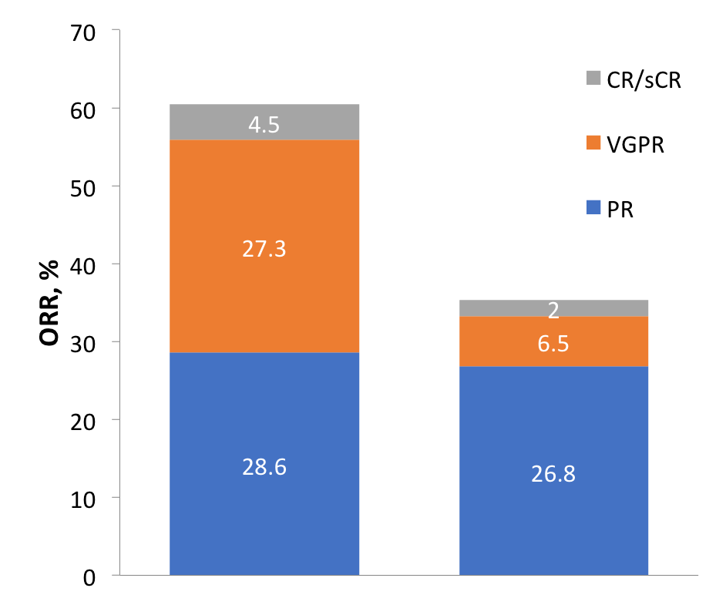
ICARIA-MM: Response
ORR = 60.4%
≥VGPR: 31.8%
P <.001
Median time to first response: Isa-Pd = 35 days vs Pd = 58 days
True CR rate in Isa-Pd underestimated because of isatuximab interference with
M-protein measurement
CR/sCR: 4.5%
ORR = 35.3%
CR/sCR: 2.0%
 | Isa-Pd (n = 154) | Pd (n = 153)
nCR, % | 15.6 | 3.3
≥VGPR: 8.5%
MRD negativity at 10⁻⁵ (ITT): 5.2% for Isa-Pd vs 0% for Pd
Isa-Pd
(n = 154)
Pd
(n = 153)
Notes:
Prepared for redraw.

Slide 63
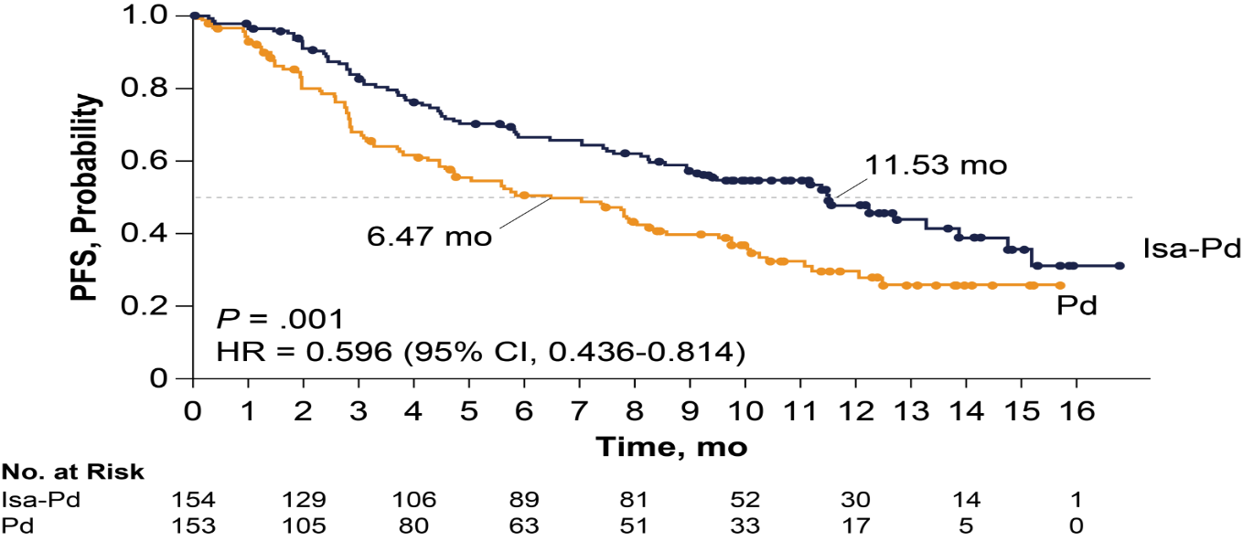
ICARIA-MM: PFS
Notes:
Prepared for redraw
Richardson P.G. et al. A phase III randomized, open label, multicenter study comparing isatuximab, pomalidomide, and low-dose dexamethasone versus pomalidomide and low-dose dexamethasone in patients with relapsed/refractory multiple myeloma (R/R MM). Abstract #8004. American Society of Clinical Oncology meeting, Chicago, US. 2019 Jun 02

Slide 64
CANDOR (KdD vs Kd in RRMM)
The CANDOR study previously demonstrated that KdD improved progression-free survival (PFS) vs Kd (HR, 0.63;
95% CI, 0.46–0.85) in patients with RRMM¹
This abstract reports updated efficacy and safety outcomes from CANDOR up to the data cutoff of ~36 months after enrollment of the first patient²
28-day cycles until disease progression
KdD (n = 312)
Carfilzomib* (20/56 mg/m² IV; days 1, 2, 8, 9, 15, 16)
+
Dexamethasone† (40 mg)
+
Daratumumab‡ (16 mg/kg IV)
N = 466
Key inclusion criteria
RRMM
1–3 prior lines of therapy
≥PR to ≥1 line
Ran
2:1
Kd (n = 154)
Carfilzomib* (20/56 mg/m² IV; days 1, 2, 8, 9, 15, 16)
+
Dexamethasone† (40 mg)
Primary endpoint: PFS§
Select secondary endpoints: ORR, MRD-negative CR at 12 months, OS, safety
*Carfilzomib dose was 20 mg/m² on days 1 and 2 of cycle 1. †PO or IV weekly; 20 mg for patients >75 years. ‡8 mg/kg on days 1 and 2 of cycle 1; 16 mg/kg weekly thereafter for cycles 1–2; Q2W for cycles 3–6; and Q4W thereafter. §Disease progression was determined locally by investigators in an unblinded manner and centrally by the sponsor using a validated computer algorithm (ORCA) in a blinded manner.
CR, complete response; HR, hazard ratio; IV, intravenous; Kd, carfilzomib, dexamethasone; KdD, carfilzomib, dexamethasone, daratumumab; MRD, minimal residual disease; ORCA, Onyx Response Computer Algorithm; ORR, overall response rate; OS, overall survival; PFS, progression-free survival; PO, per oral; PR, partial response; Q2W, once every 2 weeks; Q4W, once every 4 weeks; Ran, randomized; RRMM, relapsed or refractory multiple myeloma.
1. Dimopoulos M, et al. Lancet. 2020;396:186-197; 2. Dimopoulos M, et al. ASH 2020. Abstract 2325.
Notes:
Dimopoulos Lancet 2020: 190-A-Figure 2
Dimopoulos ASH 2020, Abstract 2325 : 1-A-1
Dimopoulos Lancet 2020: 187-B-1; 188-A-4; 188-A-5; 188-B-Figure 1; 188-B-3
Dimopoulos ASH 2020, Abstract 2325: 1-A-2
Dimopoulos ASH 2020, Abstract 2325: 1-A-1; 1-A-2

Slide 65
CANDOR (KdD vs Kd in RRMM)
 | KdD (n = 312) | Kd (n = 154)
Patients with PFS events, n (%) | 140 (44.9) | 85 (55.2)
Median PFS,* months | 28.6 | 15.2
HR (95% CI) | 0.59 (0.45–0.78)
Safety | KdD (n = 312) | Kd (n = 154)
Grade ≥3 AEs, % | 87.0 | 75.8
Fatal AEs,† % | 8.8 | 4.6
Carfilzomib discontinuation due to AEs, % | 26.0 | 22.2
Exposure-adjusted AE rates, per 100 patient-years: Grade ≥3 AEs Fatal AEs | 171.2 6.9 | 151.9 5.6
1.0
Proportion surviving without progression
0.8
0.6
0.4
0.2
KdD Kd
0.0
0
3
6
9
12
15
18
21
24
27
30
33
36
Months from randomization
Number at Risk
KdD | 312 | 279 | 235 | 210 | 189 | 178 | 159 | 146 | 136 | 105 | 30 | 6 | 0
Kd | 154 | 120 | 99 | 83 | 69 | 57 | 47 | 44 | 39 | 28 | 4 | 1 | 0
Safety was consistent with previously reported results
KdD continues to show a favorable benefit-risk profile
With ~11 months of additional follow-up, median PFS was
improved in patients treated with KdD (28.6 months) vs Kd (15.2 months)
*By ORCA. †One fatal AE in the KdD arm (due to arrhythmia) and 1 fatal AE in the Kd arm (due to COVID-19 pneumonia) had occurred since the primary analysis.
AE, adverse event; HR, hazard ratio; Kd, carfilzomib, dexamethasone; KdD, carfilzomib, dexamethasone, daratumumab; ORCA, Onyx Response Computer Algorithm; PFS, progression-free survival; RRMM, relapsed or refractory multiple myeloma.
Dimopoulos M, et al. ASH 2020. Abstract 2325.
Notes:
Dimopoulos ASH 2020, Abstract 2325: 2-A-Figure 1; 1-A-3
Dimopoulos ASH 2020, Abstract 2325: 1-A-4
Dimopoulos ASH 2020, Abstract 2325: 1-A-3; 1-A-4

Slide 66
CANDOR (KdD vs Kd in RRMM)
Subgroup Analyses of MRD-Negative Rates at 12 Months for Patients Who Achieved CR
This posthoc analysis evaluated MRD in patients participating in CANDOR
MRD was evaluated by next-generation sequencing (threshold <10^{–5} unless otherwise specified)
 | Kd |  | KdD |  | Odds Ratio (95% CI)
Group | n/N | MRD[-]CR | n/N | MRD[-]CR
Prior lines of therapy per IXRS
1 | 1/67 | 1.5% | 22/133 | 16.5% | 13.1 (1.7, 99.3)
≥2 | 1/87 | 1.1% | 17/179 | 9.5% | 9.0 (1.2, 69.0)
Age at baseline, years
≤75 | 1/136 | 0.7% | 37/287 | 12.9% | 20.0 (2.7, 147.2)
>75 | 1/18 | 5.6% | 2/25 | 8.0% | 1.5 (0.1, 17.7)
Baseline CrCl, mL/min
≥15 to 49 | 0/27 | 0.0% | 4/38 | 10.5% | NE
≥50 to 79 | 1/50 | 2.0% | 14/97 | 14.4% | 8.3 (1.0, 64.8)
≥80 | 1/77 | 1.3% | 21/176 | 11.9% | 10.3 (1.4, 78.0)
Prior lenalidomide
Yes | 0/74 | 0.0% | 14/123 | 11.4% | NE
No | 2/80 | 2.5% | 25/189 | 13.2% | 5.9 (1.4, 25.7)
Refractory to lenalidomide
Yes | 0/55 | 0.0% | 13/99 | 13.1% | NE
No | 2/99 | 2.0% | 26/213 | 12.2% | 6.7 (1.6, 29.0)
Prior bortezomib or ixazomib exposure
Yes | 2/137 | 1.5% | 34/289 | 11.8% | 9.0 (2.1, 38.0)
No | 0/17 | 0.0% | 5/23 | 21.7% | NE
Refractory to bortezomib or ixazomib
Yes | 1/55 | 1.8% | 7/100 | 7.0% | 4.1 (0.5, 33.9)
No | 1/99 | 1.0% | 32/212 | 15.1% | 17.4 (2.3, 129.4)
Prior IMiD exposure
Yes | 0/110 | 0.0% | 24/206 | 11.7% | NE
No | 2/44 | 4.5% | 15/106 | 14.2% | 3.5 (0.8, 15.8)
Refractory to IMiD
Yes | 0/65 | 0.0% | 16/130 | 12.3% | NE
No | 2/89 | 2.2% | 23/182 | 12.6% | 6.3 (1.4, 27.3)
 | Kd | KdD | OR | P Value
Best overall MRD- negative CR rate at any time | 3.2% | 13.8% | 4.95 | <.0001
MRD negative regardless of overall response status | 5.8% | 22.8% | 5.15 | <.0001
MRD-negative CR rate at 12 months | 1.3% | 12.5% | 11.3 | <.0001
    MRD-negative CR rates at the 12-month landmark for KdD vs Kd were consistent across clinically relevant subgroups
Landgren O, et al. ASH 2020. Abstract 2282.
Notes:
Landgren ASH 2020, Abstract 2282: 2-A-Table
Landgren ASH 2020, Abstract 2282: 1-A-3
Landgren ASH 2020, Abstract 2282: 1-A-1; 1-A-2

Slide 67
CANDOR (KdD vs Kd in RRMM)
MRD in Patients With CR at 12-Month Landmark
At the 12-month landmark, patients treated with KdD had a greater proportion of CR rates (26.9% vs 9.7%) and deeper MRD responses than patients treated with Kd
Among patients with CR, depth of response was deeper for KdD relative to Kd regardless of MRD sensitivity
Within the KdD arm, prior lenalidomide exposure or refractoriness did not diminish the MRD-negative CR rate
With a median of 6 months follow-up, no patients with MRD-negative CR progressed
22.6%
n = 19
13.3%; n = 2
23.8%
n = 20
16.7%
n = 14
36.9%
n = 31
>10^{–4}
10^{–4} to 10^{–5}
10^{–5} to 10^{–6}
<10^{–6}
Patients treated with KdD achieved significantly higher MRD-negative CR rates vs Kd at 12 months,
which supports the efficacy of the KdD regimen as an effective treatment for RRMM including patients
who have become refractory to lenalidomide
Landgren O, et al. ASH 2020. Abstract 2282.
Notes:
Landgren ASH 2020, Abstract 2282: 2-A-Figure
Landgren ASH 2020, Abstract 2282: 1-A-4; 1-A-5
Landgren ASH 2020, Abstract 2282: 1-A-6

Slide 68
IKEMA
Moreau P, et al. Lancet. 2021;397:P2361-P2371.

Slide 69
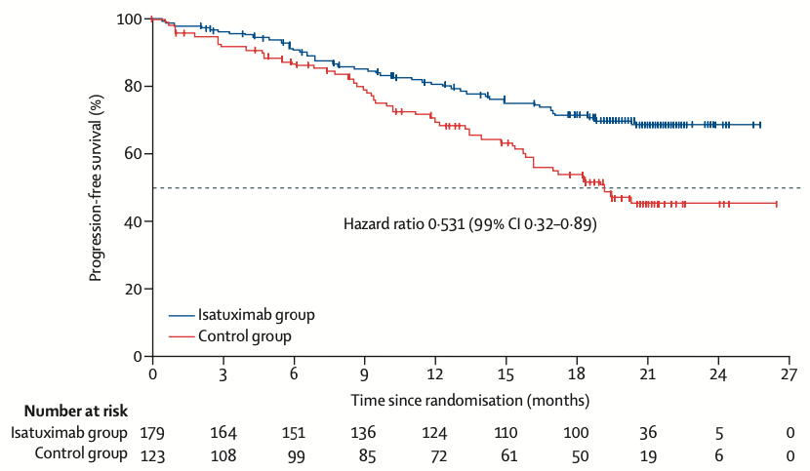
IKEMA
I-Kd ORR = 86.6%
≥VGPR = 72.6%
CR = 39.7%
Moreau P, et al. Lancet. 2021;397:P2361-P2371.

Slide 70
MRD Results
CANDOR
IKEMA
Moreau P, et al. Lancet. 2021;397:P2361-P2371.

Slide 71
Anti-CD38 at Relapse
Studies | POLLUX¹ DRd vs Rd | APOLLO¹ DPd vs Pd | CANDOR¹ DKd vs Kd | MAIA² DRd vs Rd | CASTOR^{3,4} DVd vs Vd | ICARIA¹ IPd vs Pd | IKEMA¹ Ikd vs Kd
 | 2 publications |  | Lancet | NEJM 2019 | 2 publications | ASCO 2019 | ASCO 2021
 | Daratumumab |  |  |  |  | Isatuximab
Eligibility (prior lines of Rx) | 1 | 1–3 | 1–3 | NDMM | 1 | 2+ | 1–3
n | 569 | 304 | 466 | 737 | 498 | 307 | 302
mPFS Exp (mo) | 44.5 | 12.4 | 28.6 | 44.5 | 16.7 | 11.5 | NR
mPFS Control (mo) | 17.5 | 6.9 | 15.2 | 17.5 | 7.1 | 6.5 | 19.2
Median no. prior lines | 1 | 2 | 2 | 0 | 2 | 3 | NA
1 prior line | 53% | 11% | 46% | NA | 49% | NA | NA
2 prior lines | 30% | 89% (combined) | 54% (combined) | NA | 28% | NA | NA
3 or more | 19% | 89% (combined) | 54% (combined) | NA | 24% | NA | NA
High risk | 15% | 38% | 15% | 14% | 8% | 20% | 24%
Deletion 17p13 | 11% | NA | NA | Not defined | 5% | NA | NA
ORR experimental | 93% | 69% | 84% | 93% | 85% | 60% | 87%
MRD experimental | 22% | 9% | 14% | 81% | 63% | 5% (-5) | 30%
1. https://twitter.com/Rfonsi1/status/1397594631148384257; 2. Facon T, et al. Lancet. 2021;11:P1582-P1596; 3. Weisel, et al. Am J Hematol. 2020;95:548-567;
4. Mateos MV, et al. Clin Lymphoma Myeloma Leuk. 2020;20:509-518.

Slide 72
Thank you!
They say you cannot compare trials?
FALSE – we always do.
You just cannot conclude!
But you can postulate hypotheses.

Slide 73
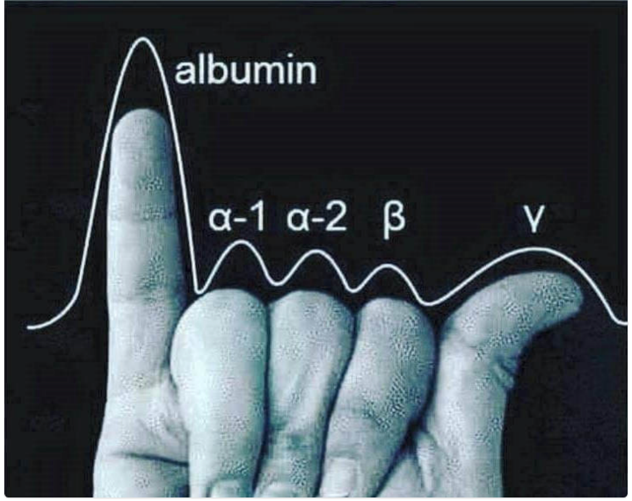
Thank you!

Slide 74
Discussion

Slide 75
Management of Heavily Pretreated Multiple Myeloma
Keith Stewart, MBChB, MBA

Slide 76

Keith Stewart, MBChB, MBA
Professor of Medicine
Director, Princess Margaret Cancer Centre
Toronto
Management of Heavily Pretreated Multiple Myeloma

Slide 77
What approximate percentage of MM patients are estimated to survive long enough to receive third-line therapy?
?
  90%
  80%
  65%
  50%
  40%

Slide 78
Which of the following is a true statement about belantamab mafodotin?
?
  Ocular toxicity can be reduced by starting with graduated dosing
  A less common but significant toxicity is early onset cytokine release syndrome
  The response rate is 30%–35% partial response or better
  The response rate in first relapse is 72%
  Ocular toxicity is manageable with steroid eye drops

Slide 79
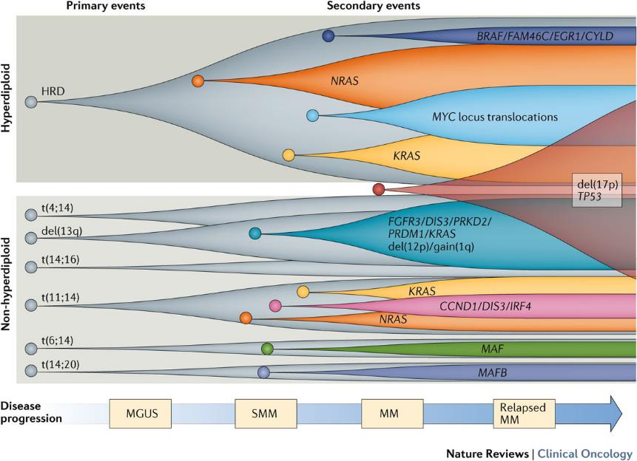
Relapsed MM Is a Biologically and Genetically Heterogeneous Disease
Manier S, et al. Nat Rev Clin Oncol. 2017;14(2):100-113.
Notes:
Clonal evolution in MM before and after therapy can follow several patterns: a linear clonal shift, a branching clonal shift or stability of the tumour, with no changes in subclonal heterogeneity^{7,106}. In the case of linear evolution (which occurs in ∼40% of patients), a shift in the subclonal population distribution can be observed, indicating that either a new subclone emerges or a pre-existing subclone becomes predominant at the later time point, resulting in an apparent stepwise acquisition of driver mutations. Branching clonal evolution (observed in ∼25% of patients) involves one or more subclones emerging at the later time point — through divergent mutational pathways — while other subclones decline in frequency or disappear. Finally, in situations of clonal stability (occurring in 35% of patients with MM), the same composition of clonal and subclonal heterogeneity is found before and after treatment, suggesting that all subclones are affected by therapy and will repopulate the tumour equivalently. Of note, the complexity of subclonal heterogeneity is dependent on the sensitivity of the assay, especially the depth of sequencing, used to evaluate such heterogeneity. In addition, the indicated percentages were observed in a cohort of only 15 patients from whom sequential samples were obtained⁷; ideally, larger cohorts are needed to better characterize the clonal evolution patterns of MM.

Slide 80
Only a Few MM Patients Reach Later Lines of Therapy
MM pts reaching LOT, %
1L
95%
2L
61%
3L
38%
4L
15%
5L
1%
Attrition by LOT, %
34%
23%
23%
14%
In every new LOT, ~15%–35% of patients are lost
Figure adapted from: Yong K, et al. Br J Haematol. 2016;175(2):252-264.

Slide 81
IMiDs
What to Do After Lenalidomide and Pomalidomide?

Slide 82
Iberdomide MM-001 Phase Ib/IIa Trial: Study Design
3 triplet cohorts
Phase I
Cohort A:
IBER
Cohort B:
IBER +
DEXª
Cohort E:
IBER +
DARA + DEX
Cohort F:
IBER +
BORT + DEX
Cohort G:^{b}
IBER +
CFZ + DEX
R/R MM
Prior LEN or POM
Prior PI
Documented PD during or within
60 days of last antimyeloma therapy
21/28-day cycles
21/28-day cycles
21/28-day cycles
14/21-day cycles
21/28-day cycles
0.3 mg qd
0.3 mg qd
0.45 mg qd
0.45 mg qd
0.6 mg qd
0.6 mg qd
0.75 mg qd
0.75 mg qd
0.9 mg qd
0.9 mg qd
1.0 mg qd
1.0 mg qd
1.0 mg qd
1.0 mg qd
1.1 mg qd
1.1 mg qd
1.1 mg qd
1.1 mg qd
1.2 mg qd
1.3 mg qd
Phase II
Cohort C:
IBER (RP2D)
Cohort D:
IBER (RP2D) + DEXª
Study objective: Determine the MTD/RP2D and efficacy of IBER in R/R MM
ªDEX given at a dose of 40 mg (20 mg in patients aged >75 years) on days 1, 8, 15, and 22 of each 28-day cycle. ^{b}CFZ dosed once weekly (Cohort G1) or twice weekly (Cohort G2).
CFZ, carfilzomib; DEX, dexamethasone; MTD, maximum tolerated dose; PD, progressive disease; PI, proteasome inhibitor; qd, once daily; RP2D, recommended phase II dose;
R/R MM, relapsed/refractory multiple myeloma.
Lonial S, et al. ASCO 2019. Abstract 8006.
Notes:
The starting dose of iberdomide in cohorts A and B was 0.3 mg once daily
Supported by phase 1 data in healthy volunteers
The starting dose in triplet regimen cohorts was 1 dose level below the maximum dose level of iberdomide previously determined to be tolerable in cohort B
1.0 mg for IBER + DARA + DEX and IBER + BORT + DEX
Reported outcomes are for patients in cohort B (IBER + DEX), with April 15, 2019 data cut
The 3 patients treated at 1.3 mg were recently enrolled and lack sufficient follow-up time for full safety and efficacy analyses; however, they are included in the population reported in this presentation

Slide 83
Response
ORR 32.2%
ORR 35.3%
ORR 29.6%
2 (3.4)
1 (2.0)
1 (3.7)
CBR
49.2%
17 (28.8)
17 (33.3)
7 (25.9)
DCR
84.7%
4 (14.8)
10 (16.9)
9 (17.7)
10 (37.0)
21 (35.6)
17 (33.3)
9 (15.3)
7 (13.7)
5 (18.5)
Evaluable patients include those who have received ≥1 dose of IBER, had measurable disease at baseline, and ≥1 postbaseline response assessment.
ªIncludes LEN and POM.
CBR, clinical benefit rate; DCR, disease control rate; MR, minimal response; ORR, overall response rate; PR, partial response; SD, stable disease; VGPR, very good partial response.
Lonial S, et al. ASCO 2019. Abstract 8006.

Slide 84
Best Response: IBER + DARA + DEX Cohort
ORRª 42.3%
Dose level | Prior reg, n | Prior DARA | C2 | C3 |  |  |  | C4 |  |  |  | C5 |  |  |  | C6 |  |  |  | C7 |  |  |  | C8 |  |  |  | C9 |  |  |  | C10 |  |  |  | C11 |  |  |  |  |  | C12 |  |  |  | C13 |  |  |  | C14 |  |  |  | C15 |  |  |  | C16 |  |  |  | C17 |  |  |  | C18 |  |  |  | C19 |  |  |  | C20
1 mg | 4 | Ref | PD
 | 3 | Ref | SD |  |  |  |  |  |  |  |  |  |  |  |  | PD
 | 7 | Ref | SD | PD
1.1 mg | 11 | Ref | MR |  |  |  |  |  |  |  |  |  |  |  |  |  |  |  |  | NE |  |  |  | PD
 | 8 | Ref | SD |  |  |  |  |  |  |  |  |  |  |  |  | PD
 | 2 | Naive | PR |  |  |  |  |  |  |  |  |  |  |  |  |  |  |  |  |  |  |  |  |  |  |  |  |  |  |  |  | VGPR |  |  |  |  |  |  |  |  |  |  |  |  |  |  |  |  |  |  |  |  |  |  |  |  |  | sCR
1.2 mg | 4 | Ref | SD | PD
 | 3 | Naive | SD |  |  | PD
 | 5 | Naive | SD |  |  |  |  | PD
 | 4 | Ref | MR |  |  |  |  |  |  |  |  |  |  |  |  | PD
 | 2 | Naive | MR | PR |  |  |  |  |  |  |  |  |  |  |  |  |  |  |  |  |  |  |  |  |  |  |  |  |  |  |  |  |  |  |  |  |  |  |  |  |  |  |  |  |  | VGPR
1.3 mg | 3 | Naive | PR |  |  |  |  |  |  |  |  | VGPR |  |  |  |  |  |  |  |  |  |  |  |  |  |  |  |  |  |  |  | CR
 | 5 | Ref | PR
 | 11 | Exp | MR |  |  |  |  |  |  |  |  | PR
 | 2 | Naive | SD | PR |  |  |  | VGPR |  |  |  |  |  |  |  |  |  |  |  | CR
 | 12 | Ref | PD
 | 6 | Ref | MR | PR
 | 5 | Exp | SD | PD
 | 5 | Ref | PR
 | 2 | Naive | PR | VGPR
 | 6 | Naive | SD | PD
 | 3 | Ref | PD
 | 3 | Naive | PR
1.6 mg | 3 | Ref | SD | PD
 | 12 | Ref | PR
 | 4 | Ref | SD | PD
CBR
50%
sCR
DCR
88.5%
CR
VGPR
PR
MR
SD
PD^{d}
NE
On treatment
at time of
data cut
In the IBER + DARA + DEX cohort,^{b} 26 patients were IMiD refractory, 15 were anti-CD38 refractory (all DARA), and 13 were triple-class refractory^{c}
Median time to response was 4.1 (range 4.0–12.0) weeks
ªPR or better. ^{b}Full analysis population (N = 27). ^{c}Defined as refractory to ≥1 IMiD, 1 PI, and 1 anti-CD38 mAb. ^{d}One patient in the 1.2-mg group and 2 patients in the 1.3-mg group had an unconfirmed PD as of the data cutoff date.
CBR, clinical benefit rate; CR, complete response; DCR, disease control rate; Exp, exposed; MR, minimal response; MTD, maximum tolerated dose; NE, not evaluable; ORR, overall response rate; PD, progressive disease; PR, partial response; Ref, refractory; reg, regimen; sCR, stringent complete response; SD, stable disease; VGPR, very good partial response.
van de Donk NWCJ, et al. ASH 2020. Abstract 724.
Notes:
84

Slide 85
Best Response: IBER + BORT + DEX Cohort
ORRª 60.9%
Dose level | Prior reg, n | Prior BORT | C2 | C3 |  |  |  | C4 |  |  |  | C5 |  |  |  | C6 |  |  |  | C7 |  |  |  | C8 |  |  |  | C9 |  |  |  | C10 |  |  |  | C11 |  |  |  | C12 |  |  |  | C13 |  |  |  | C14 |  |  |  | C15 |  |  |  | C16 |  |  |  | C17 |  |  |  | C18 |  |  |  | C19 |  |  |  | C20 |  |  |  | C21 |  |  |  | C22
1 mg | 14 | Ref | MR |  |  |  |  |  |  |  |  | PD
 | 3 | Exp | MR | PR |  |  |  |  |  |  |  |  |  |  |  |  |  |  |  |  |  |  |  |  |  |  |  |  |  |  |  | PD
 | 7 | Exp | SD
1.1 mg | 5 | Ref | PD
 | 8 | Exp | PR | VGPR
 | 7 | Exp | SD |  |  |  |  | PD
 | 8 | Ref | PD
 | 5 | Exp | VGPR |  |  |  |  |  |  |  |  | CR
 | 5 | Exp | SD | MR |  |  |  |  |  |  |  | PR |  |  |  |  |  |  |  |  |  |  |  |  |  |  |  |  |  |  |  |  |  |  |  |  |  |  |  |  |  |  |  | PD
 | 4 | Ref | SD
1.3 mg | 3 | Ref | SD | PR |  |  |  | VGPR
 | 2 | Ref | PR |  |  |  |  | PD
 | 8 | Ref | PR |  |  |  |  |  |  |  |  |  |  |  |  | PD
 | 6 | Exp | SD
 | 11 | Ref | SD |  |  |  |  |  |  |  |  | MR
 | 7 | Ref | SD | MR |  |  |  | PR
 | 10 | Exp | SD | PR
 | 1 | Naive | PR
 | 8 | Exp | SD
 | 1 | Exp | PR
1.6 mg | 8 | Exp | PR |  |  |  |  | VGPR
 | 4 | Exp | VGPR
 | 8 | Exp | VGPR
CBR
69.6%
DCR
87.0%
CR
VGPR
PR
MR
SD
PD^{d}
On treatment
at time of
data cut
In the IBER + BORT + DEX cohort,^{b} 18 patients were IMiD refractory, 15 were PI refractory, 9 were BORT refractory, and 9 were triple-class refractory^{c}
Median time to response was 3.6 (range 3.0–13.1) weeks
ªPR or better. ^{b}Full analysis population (N = 23). ^{c}Defined as refractory to ≥1 IMiD, 1 PI, and 1 anti-CD38 mAb. ^{d}One patient in the 1.1-mg group had an unconfirmed PD as of the data cutoff date.
van de Donk NWCJ, et al. ASH 2020. Abstract 724.
Notes:
85

Slide 86
Novel Combinations?

Slide 87
CANDOR: CAR-DARA-DEX vs CAR-DEX
Patients
N = 466
Key eligibility criteria
R/R MM
1 to 3 prior therapies with
≥PR to ≥1 prior therapy
ECOG PS 0 to 2
CrCI ≥20 mL/min
LVEF ≥40%
N = 312
Carfilzomib at 56 mg/m²
Dexamethasone 40 mg
Daratumumab 16 mg/kg
Primary endpoint:
PFS
Key
secondary:
ORR, MRD, OS
R
2:1
Treatment until disease progression
Carfilzomib at 56 mg/m²
Dexamethasone 40 mg
N = 154
28-day
cycles
0
4
8
12
16
20
24
28
32
Months
MRD sample:
Baseline
MRD sample:
Landmark analysis MRD-negative CR rate
MRD sample:
Landmark analysis Sustained MRD-negative CR rate
Usmani SZ, et al. ASH 2019. Abstract LBA6.

Slide 88
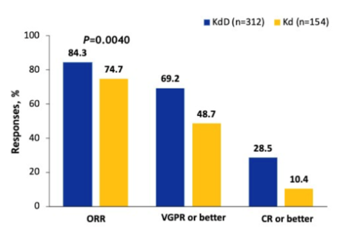
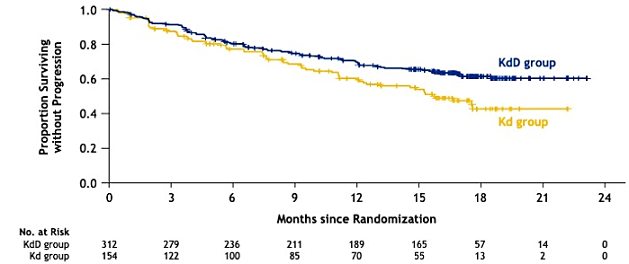
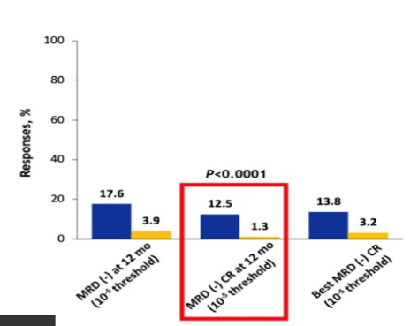
CANDOR: Response and PFS
Response
MRD
 | KdD (n = 312) | Kd (n = 154)
Median follow-up time, months | 16.9 | 16.3
Progression/death, n (%) | 110 (35%) | 68 (44%)
Median PFS, months | NE | 15.8
HR (KdD/Kd) (95% CI) | 0.63 (0.46–0.85)
P value (1-sided) | .0014
Usmani SZ, et al. ASH 2019. Abstract LBA6.

Slide 89
CANDOR: AEs of Interest
AE, n (%) | CAR-DARA-DEX (n = 308) |  | CAR-DEX (n = 153)
 | All grades | Grade ≥3 | All grades | Grade ≥3
Acute renal failure | 18 (5.8) | 9 (2.9) | 12 (7.8) | 10 (6.5)
Cardiac failure | 23 (7.5) | 12 (3.9) | 16 (10.5) | 13 (8.5)
Ischemic heart disease | 13 (4.2) | 9 (2.9) | 5 (3.3) | 4 (2.6)
Respiratory tract infection | 225 (73.1) | 89 (28.9) | 84 (54.9) | 24 (15.7)
Peripheral neuropathy | 53 (17.2) | 3 (1.0) | 13 (8.5) | 0
Hypertension | 98 (31.8) | 55 (17.9) | 44 (28.8) | 21 (13.7)
IRR (on same day as any K) | 126 (40.9) | 38 (12.3) | 43 (28.1) | 8 (5.2)
DARA-related infusion reactions | 56 (18.2) | 7 (2.3) | 0 | 0
Viral infections | 63 (20.5) | 19 (6.2) | 22 (14.4) | 3 (2.0)
  30 fatal events (9.7%) on Car-Dara-Dex vs 8 (5.2%) on Car-Dex
    14 (4.5%) due to infections vs 5 (2.6%) with Car-Dex; 4 (1.4%) due to cardiac disorders vs 0 with Car-Dex
Usmani SZ, et al. ASH 2019. Abstract LBA6.

Slide 90
Phase III ICARIA-MM Study: Isatuximab + Pomalidomide-Dexamethasone in R/R MM^{1,2}
Isatuximabª + pomalidomide + dexamethasone 28-d cycles
(n = 150)
R/R MM
≥2 prior lines of therapy
Prior IMiD and PI
Progressed ≤60 d of prior therapy
(N = 300)
Until disease progression, occurrence of unacceptable AEs, or patient’s decision to discontinue
the study
R
Pomalidomide + dexamethasone
(n = 150)
Primary endpoint: PFS
Key secondary endpoints: ORR, OS, safety

Slide 91
ICARIA-MM: Response
ORR = 60.4%
≥VGPR: 31.8%
P <.001
Median time to first response: ISA-Pd = 35 days vs Pd = 58 days
True CR rate in ISA-Pd underestimated because of ISA interference with M-protein measurement
CR/sCR: 4.5%
ORR = 35.3%
CR/sCR: 2.0%
 | ISA-Pd (n = 154) | Pd (n = 153)
nCR, % | 15.6 | 3.3
≥ VGPR: 8.5%
MRD negativity at 10⁻⁵ (ITT): 5.2% for ISA-Pd vs 0% for Pd
ISA-Pd
(n = 154)
Pd
(n = 153)
Notes:
Prepared for redraw.

Slide 92
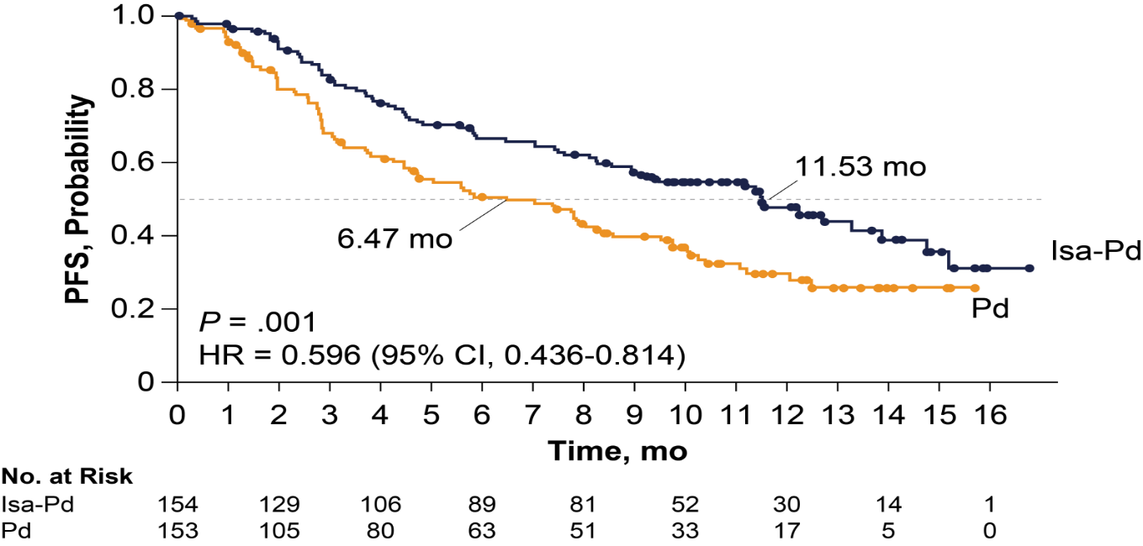
ICARIA-MM: PFS (by IRC)
Notes:
Prepared for redraw
Richardson P.G. et al. A phase III randomized, open label, multicenter study comparing isatuximab, pomalidomide, and low-dose dexamethasone versus pomalidomide and low-dose dexamethasone in patients with relapsed/refractory multiple myeloma (R/R MM). Abstract #8004. American Society of Clinical Oncology meeting, Chicago, US. 2019 Jun 02

Slide 93
New Small Molecules

Slide 94
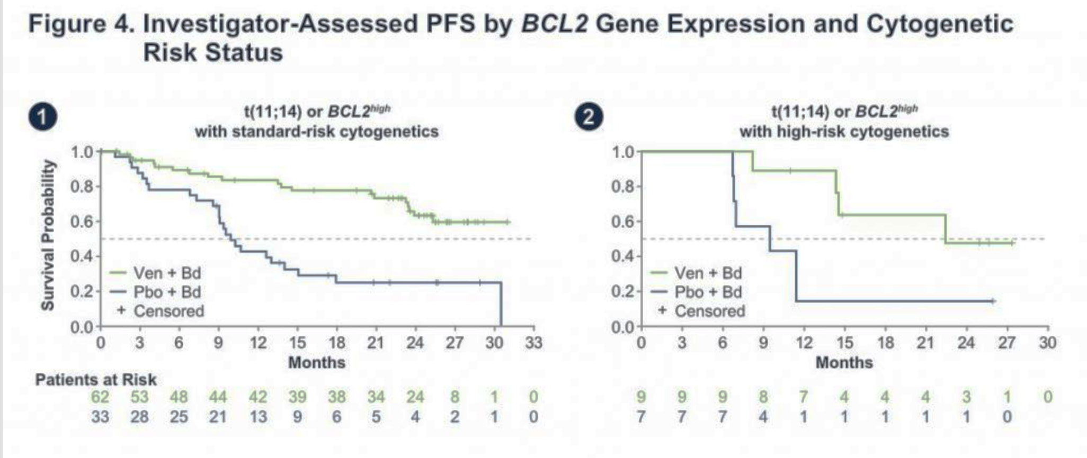
Venetoclax-Bortezomib-DEX Highly Active in t(11;14) or High BCL2

Slide 95
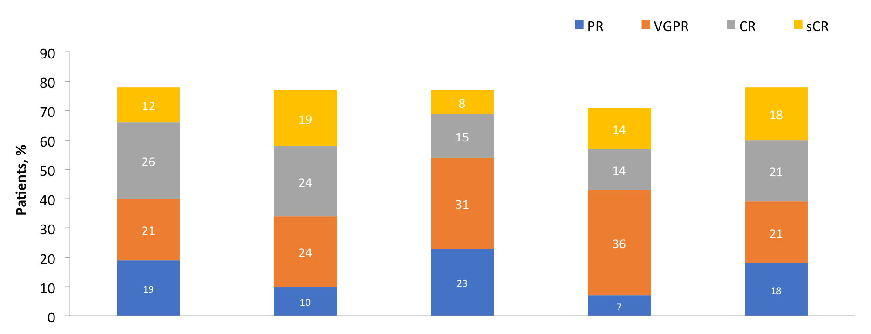
. . . And With Carfilzomib-Dexamethasoneª
N = 42 patients with R/R MM
ORR = 79%
ORR = 76%
ORR = 77%
ORR = 79%
ORR = 71%
≥ CR: 38%
All Patients^{b}
(N = 42)
PI Refractory
(n = 21)
IMiD Refractory
(n = 26)
Double
Refractory^{b}
(n = 22)
Target Dose Level
Notes:
Add a note about BELINI study

Slide 96
STORM Part II Study Design
Oral selinexor 80 mg + dexamethasone 20 mg
Selinexor-dexamethasone twice weekly, days 1, 3, until disease progression
Patient population
  MM, prior treatment with PI, IMiD, CD38 mAb, alkylator, steroids
  Refractory to ≥1 PI, ≥1 IMiD, daratumumab, steroid
Primary endpoint
  Overall response rate
Secondary endpoints
  Duration of response
  Clinical benefit rate
  Overall survival
  PFS
Key eligibility criteria
  Creat clearance ≥20 mL/min
  ANC ≥1,000/mm³
  Plt ≥75,000
  Hemoglobin ≥8.5 g/dL
Chari A, et al. N Engl J Med. 2019;381(8):727-738.

Slide 97
Phase II STORM Trial: Response Assessment
Variable | N | ORR (CR + VGPR + PR) | CBR (CR + VGPR + PR + MR)
Total | 122 | 32 (26%) | 48 (39%)
Penta-refractory | 83 | 21 (25%) | 31 (37%)
Quad-refractory | 101 | 26 (26%) | 37 (37%)
High-risk cytogenetic featureª | 65 | 12 (18%) | 24 (37%)
ªThis category included any of del(17p)/p53, t(14;16), t(4;14), or 1q21 (1q gain >2).
Chari A, et al. N Engl J Med. 2019;381(8):727-738.

Slide 98
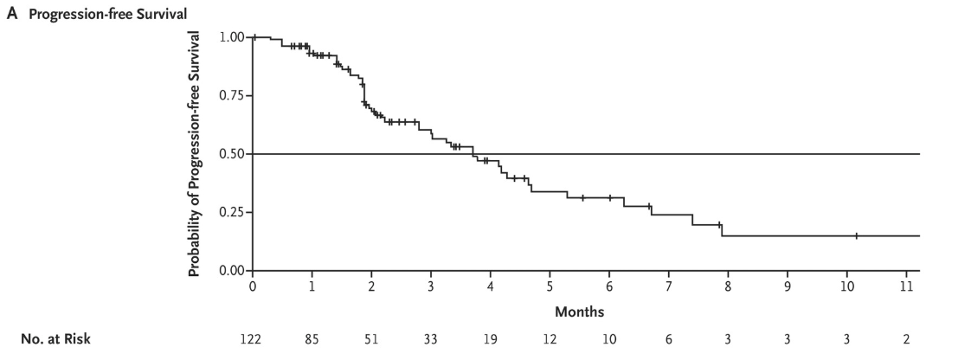
STORM Trial: Kaplan-Meier Analysis for PFS
Median PFS: 3.7 months
Median duration of response: 4.4 months
Chari A, et al. N Engl J Med. 2019;381(8):727-738.
Notes:
Contrast with FDA approval of carfilzomib:
003-A1 trial of carfilzomib that got Kyprolis accelerated approval
Median PFS 3.7 months, median DOR 7.8 mos

Slide 99
STORM: Selinexor Toxicity
Most commonly occurring grade ≥3 AEs
Hematologic, GI related, constitutional symptoms, and hyponatremia
Typically responsive to dose modification and standard supportive care agents
Early identification of AEs, frequent assessment, and use of supportive care measures deemed crucial to toxicity management, including
Fatigue: methylphenidate
GI: ondansetron, olanzapine, or substance P/neurokinin antagonists
Hyponatremia: hydration (oral or IV), salt replacement
Thrombocytopenia: romiplostim or eltrombopag if selinexor dose held
Chari A, et al. ASH 2018. Abstract 598.

Slide 100
BOSTON Trial: Selinexor-Vd Compared With Vd
1.00
Median PFS (months) SVd 13.93
Vd 9.46
Treatment Group
0.75
SVd arm
Vd arm
0.50
Probability of PFS
0.25
0.00
Hazard ratioª: 0.70; P = .0075 30% reduced risk of progression/death with SVd
0
1
2
3
4
5
6
7
8
9
10
11
12
13
14
15
16
17
18
19
20
21
22
23
24
25
26
Time (Months)
SVd arm
Vd arm
195
207
187
187
175
175
152
152
135
138
117
127
106
111
89
100
79
90
76
81
69
66
64
59
57
56
51
53
45
49
41
42
35
35
27
26
26
20
22
16
19
10
14
8
9
5
7
4
6
3
4
3
2
2
Median follow-up: 13.2 and 16.5 months in SVd and Vd arms, respectively.
Intention-to-treat (ITT) population N = 402; data cutoff February 18, 2020.
ªHazard ratio 95% CI = 0.53–0.93 one-sided P value.
Dimopoulos MA, et al. ASCO 2020. Abstract 8501.

Slide 101
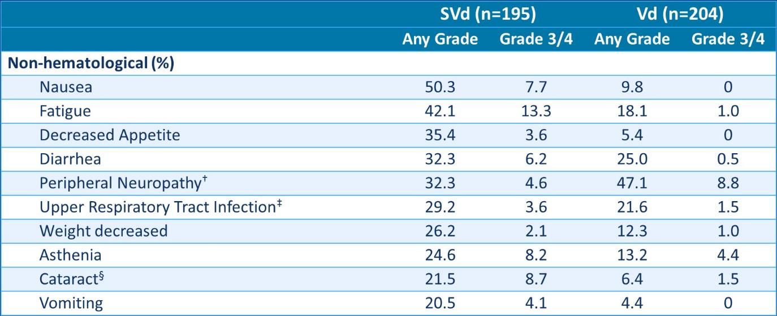
BOSTON Trial: Safety – Selected Nonhematologic TEAEs*
*Shown are events that occurred in at least 15% of patients and had a >5% difference between treatment arms. Adverse events were graded according to the National Cancer Institute Common Terminology Criteria for Adverse Events, version 4.03. For patients who crossed over, adverse events that occurred after the crossover are not included. †Includes high-level term Peripheral Neuropathies NEC. ‡Includes upper respiratory infection, nasopharyngitis, pharyngitis, respiratory syncytial virus infection, respiratory tract infection, rhinitis, and viral upper respiratory tract infection. §Per ophthalmology exam after 24% of patients on SVd arm vs 8.5% of patients on the Vd arm had new-onset cataracts, and worsening of cataracts on study was noted in 20.5% of patients on the SVd arm vs 7.9% on the Vd arm. Data cutoff February 18, 2020.
Dimopoulos MA, et al. ASCO 2020. Abstract 8501.

Slide 102
Belantamab Mafodotin: BCMA-Targeted ADC
  Belantamab mafodotin
    Humanized, afucosylated IgG1 anti-BCMA antibody
    Conjugated to microtubule-disrupting agent MMAF via a stable, protease-resistant maleimidocaproyl linker
  Preclinical studies demonstrate its selective and potent activity
ADC
ADCC
Fc
receptor
Fc region of
the antibody
Target specific
Enhanced ADCC
BCMA
Lysosome
Effector cell
BCMA
BCMA
BCMA
Linker
Stable in circulation
x
GSK2857916
Malignant
plasma
cell
Drug
MMAF (non-cell permeable, highly potent auristatin)
Cell death
Mechanisms of action:
ADC mechanism
ADCC mechanism
Immunogenic cell death
Tai YT, et al. Blood. 2014;123: abstract 3128.
Notes:
ADC = antibody-drug conjugate
ADCC = antibody-dependent cell-mediated cytotoxicity
BCMA = B-cell maturation antigen
Fc = fragment crystallizable
IgG = immunoglobulin G
MMAF = monomethyl auristatin-F

Slide 103
Belantamab Mafodotin: DREAMM-2 – Response
  ORR
  30/97 patients (31%) in the 2.5-mg/kg cohort
  34/99 patients (34%) in the 3.4-mg/kg cohort
  Adverse events
  Most common grade 3/4 AE
    Keratopathy (27% in the 2.5-mg/kg cohort; 21% in the 3.4-mg/kg cohort)
    Thrombocytopenia (20% and 33%)
    Anemia (20% and 25%)
  Serious AE in 40% in 2.5-mg/kg cohort and 47% in the 3.4-mg/kg cohort
  2 deaths were potentially treatment related
    Sepsis in the 2.5-mg/kg cohort and hemophagocytic lymphohistiocytosis in the
    3.4-mg/kg cohort
Lonial S, et al. Lancet Oncol. 2019;21(2):207-221.

Slide 104
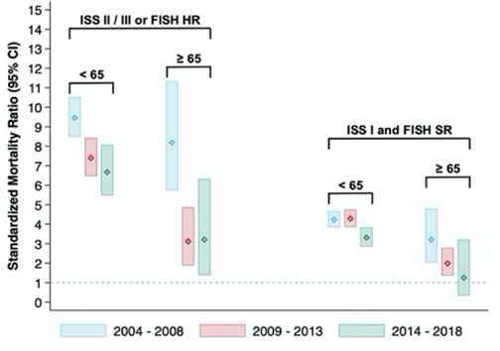
Results
Impact of disease-related factors on survival outcomes
Patients with favorable disease characteristics fared better from advances in myeloma care
Older patients without HR disease and with ISS I had comparable outcomes to that of US general population – “functional cure”

Slide 105
Summary
No “one-size-fits-all”
Daratumumab (or isatuximab) as a backbone logical
Carfilzomib > bortezomib > ixazomib
It’s not either-or – DARA and carfilzomib is a powerful combination
Iberdomide > pomalidomide > lenalidomide
Save selinexor for “no other options”
Belamaf very active, but eye toxicity limiting
Venetoclax if you can get it in t(11;14)

Slide 106
What approximate percentage of MM patients are estimated to survive long enough to receive third-line therapy?
?
  90%
  80%
  65%
  50%
  40%

Slide 107
Which of the following is a true statement about belantamab mafodotin?
?
  Ocular toxicity can be reduced by starting with graduated dosing
  A less common but significant toxicity is early onset cytokine release syndrome
  The response rate is 30%–35% partial response or better
  The response rate in first relapse is 72%
  Ocular toxicity is manageable with steroid eye drops

Slide 108
Discussion

Slide 109
Break

Slide 110
Bispecifics in Multiple Myeloma
María-Victoria Mateos, MD, PhD

Slide 111




University of Salamanca
Bispecific Monoclonal Antibodies in Myeloma
María-Victoria Mateos
University Hospital of Salamanca-IBSAL
Salamanca, Spain

Slide 112
Conflict of interest
Honoraria derived from lectures and participation in advisory boards from Janssen, Celgene, Takeda, Amgen, GSK, AbbVie, Pfizer, Regeneron, Adaptive, Roche, Sanofi, Oncopeptides, Seagen

Slide 113
Why do we need these new therapies?

Slide 114
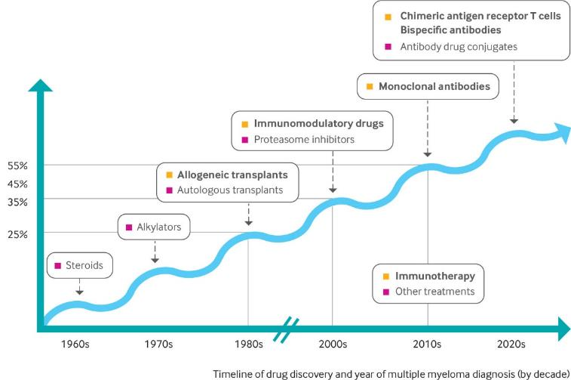
Treatment overview
Most MM patients have been exposed to PIs, IMiD® agents, and anti-CD38 mAbs during the first 2–3 lines of therapy . . .
Does this population represent an unmet medical need?
Relative survival at 5 years (%),
based on year of diagnosis
ESMO, European Society for Medical Oncology; IMiD, immunomodulatory drug; mAb, monoclonal antibody; PI, proteasome inhibitor.
Mateos MV, personal communication. Image reproduced from Shah UA, et al. BMJ. 2020;370:m3176. Moreau P, et al. Ann Oncol. 2017;28(suppl 4):iv52-iv61.

Slide 115
The unmet medical need does exist
MAMMOTH study¹
LocoMMotion study²
1.0
 | Median OS, months | 95% CI
Non–triple-refractory MM | 11.2 | 5.4–17.1
Triple- and quad-refractory MM | 9.2 | 7.1–11.2
Penta-refractory MM | 5.6 | 3.5–7.8
LocoMMotion was a prospective, non-interventional study conducted in the USA and 9 European countries to evaluate the efficacy of rescue therapies in patients with RRMM exposed to PIs, IMiDs, and anti-CD38 mAbs
0.8
0.6
Non–triple-refractory MM (n = 57)
Proportion surviving
Triple- and quad-refractory MM (n = 148)
0.4
Penta-refractory MM (n = 70)
0.2
P = .002
0
0
10
20
30
40
50
ASH21update: ORR 29.8% with only 1 pt in CR
Median PFS: 4.6 mo and median OS: 12.4 mo
Time (months)
Direct comparison between trials is not intended and should not be inferred.
CR, complete response; ORR, overall response rate; OS, overall survival; PR, partial response; RRMM, relapsed/refractory multiple myeloma;
SOC, standard of care; VGPR, very good partial response.
1. Gandhi UH, et al. Leukemia. 2019;33(9):2266-2275; 2. Mateos MV, et al. ASH 2021. Abstract 3057.

Slide 116
Do you see these results in your clinic with the TCR patients?
?
  Yes
  No

Slide 117
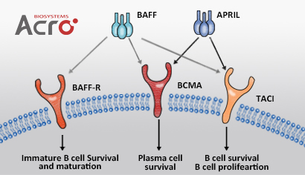
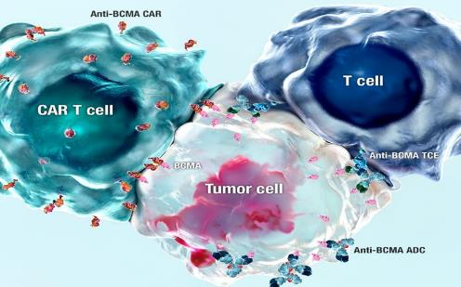

BCMA emerges as an optimal new target in MM
2
1
3
BCMA expression in PCs
In normal physical function
Support survival of long-lived PCs
Production of antibodies
Class switch of immunoglobulin
In MM
Promote proliferation and survival of MM cells
Associated with immunosuppressive BM microenvironment
1
CAR T-cell therapy (CAR T)
2
T-cell engager antibody (TCE)
3
Antibody-drug conjugate (ADC)
ADC, antibody–drug conjugate; APRIL, a proliferation inducing ligand; BAFF, B-cell activating factor; BAFF-R, B-cell activating factor receptor; BCMA, B-cell maturation antigen; BM, bone marrow; CAR, chimeric antigen receptor; TACI, transmembrane activator and calcium modulator and cyclophilin ligand interactor; TCE, T cell engager antibody.
Yu B, et al. J Hematol Oncol. 2020;13:125.

Slide 118
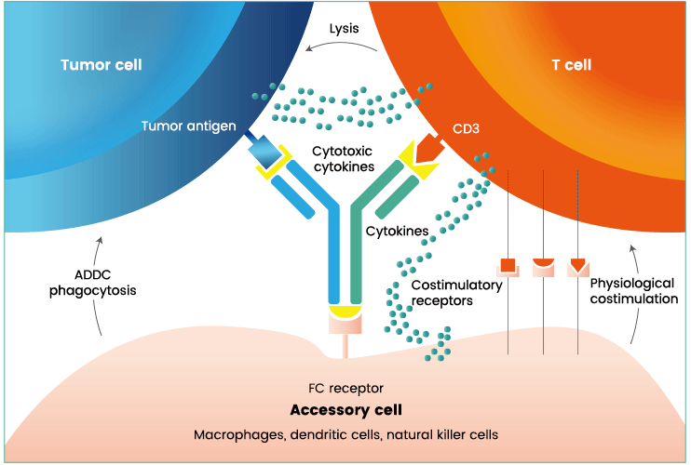
What are bi/trispecific mAbs?
There are more than 100 different bispecific antibody formats produced due to the modular architecture of antibodies.
Bispecific antibodies (bsAbs) are antibodies containing 2 antigen-binding sites for different epitopes
One binding specificity will be directed against a specific cell-surface antigen of the target cell
The other will be directed against a “triggering” molecule on the surface of the effector cell, eg, one of the FcyR or the CD3/T-cell receptor complex
The bispecific antibody can override the specificity of an effector cell for its natural target and redirect it to kill a target that it would otherwise ignore that is relevant in MM.
1. Ross SL, et al. PLoS One. 2017;12(8):e0183390; 2. Labrijn AF, et al. Nat Rev Drug Discov. 2019;18(8):585-608.
Notes:
Bispecific antibodies (bsAbs) are antibodies containing two antigen-binding sites for different epitopes (usually on two separate antigens). Typically one binding specificity will be directed against a specific cell surface antigen of the target cell and the other against a 'triggering' molecule on the surface of the effector cell, usualy the CD3 / T cell receptor complex.

Slide 119
Bispecific monoclonal antibodies in MM
BITEs: no Fc-mediated effector functions
Small size that offers better tumor tissue penetration but requires continuous IV infusion.
AMG 420 was the first BCMA-CD3 mAb evaluated in RRMM patients; promising efficacy, but the development plan moved to the other format.
2. Bispecific formats with Fc regions that retain Fc-mediated effector functions, such as CDC and ADCC, and can be delivered IV or SC and in short infusions.
Shim H. Biomolecules. 2020;10(3):360.

Slide 120
BCMA-bispecific mAbs: Efficacy
Product | n | TCR | Efficacy at the RP2D | Schedule of administration
AMG 701¹ Amgen | 85 | 62% | Dose 18 mg(n = 6): ORR 87% RC: 17% | IV infusion × 1 week
CC-93269² BMS | 30 | 66.7% | Overall: ORR: 43% RC: 17% MTD: 10 mg (n = 9): ORR:88% (RC 44%) | Weekly IV × 3 c Every other week × 3 cycles >7 cycles: Monthly *Now SC formulation
Teclistamab³ Janssen | 165 | 77.6% | Ensayo MaJestec-1 Phase 1 (n = 40) Phase 2: ( n = 125) Dose 1.5 mg/kg SC; ORR 62% RC/RCs: 28.6% | Weekly and SC
Elranatamab⁴ Pfizer | 55 | 90.9% | Ensayo MagnetisMM-1 Part 1: ≥215 mcg SC weekly (n = 20) Par 1.1: 1000 µg/kg Q1w or Q2W (n = 20) Part 2.A: 76 mg Q1W ORR: 69% RC. 30% at the dose of 1000 µg/kg 7/10 patients with previous anti-BCMA responded | SC weekly SC every other week
REGN5458⁵ Regeneron | 73 | 19% | Dose 200–8000 mg ( n= 24); ORR 75% RC/RCs: 16% | Weekly IV × 16 weeks Every other week later
TNB-383B⁶ ABBV-383 AbbVie | 118 | 61% | Dose 40–60 mg(n = 60) ORR: 60% RC: 20% Dose >40 mg: ORR 81% RC 30% | IV every 3 weeks
Most of BCMA×CD3 bispecifics abs have been evaluated in TCR MM patients.
ORR ranges 62%–88% and covers the unmet need. Follow-up is short and there are no mature data in PFS, DOR, or OS.
1. Harrison SJ, et al. ASH 2020. Abstract 181; 2. Costa LJ, et al. EHA 2020. Abstract S205; 3. Moreau P, et al. ASH 2021. Abstract 896;
4. Sebag M, et al. ASH 2021. Abstract 895; Zonder, ASH 2021. Abstract 160; Kumar SK, et al. ASH 2021. Abstract 900.

Slide 121
BCMA-bispecific mAbs: Baseline characteristics
 | AMG-701¹ | CC-93269² | Teclistamab³ | Elranatamab⁴ | REGN5458⁵ | TNB383B⁶
Inclusion criteria | RRMM ≥3 PL Expos a IMiD, Pis, and anti-CD38 | RRMM ≥3 PL | RRMM ≥3 PL Expos a IMiD, Pis, and anti-CD38 | Exposed to IMiD, Pis, and anti-CD38 Prior BCMA-targeted therapy allowed | RRMM ≥3 PL Expos a IMiD, Pis, and anti CD38 | RRMM ≥3 PL Expos a IMiD, Pis, and anti-CD38 Allo-Trx is allowed
Prior lines | 6 (2-25) | 5 (3-13) | 6 (4-7) | 8(3-15) | 5( 2-17) | 5( 1-15)
Age | 64 (34-83) | 64 (42-78) | 64 (33-84) | 63( 43-80) | 64( 41-81) | 68 ( 35-88)
ISS 3 | 26% | 30% | 12.3% | 23.3% | 23.5 % | 31% ( R-ISS 3)
HRCA | N/A | 30% | 25.9% | 23.3% | 18%
EMD | 25% | 26.7% | 17%
TCR PCR | 62% | 66.7% | 77.6% 30.3% | 98% | 13.2% 51.5 % | 61%
HRCA, high-risk cytogenetic abnormalities; EMD, extramedullary disease; TCR, triple-class refractory; PCR, penta-class refractory.
1. Harrison SJ, et al. ASH 2020. Abstract 181; 2. Costa LJ, et al. EHA 2020. Abstract S205; 3. Moreau P, et al. ASH 2021. Abstract 896;
4. Sebag M, et al. ASH 2021. Abstract 895; Zonder, ASH 2021. Abstract 160; Kumar SK, et al. ASH 2021. Abstract 900.
Notes:
Ver cuales permiten aloPTH previo

Slide 122
BCMA-bispecific mAbs: Safety profile
 | AMG-701¹ | CC-93269² | Teclistamab³ | Elranatamab⁴ | REGN5458⁵ | TNB383B⁶
CRS (G 3-4) Median onset Duration Tocilizumab | 64% (9%) - - 29% | 76.7% (3.3%) 1 (1-9) 2 (1-6) 43% | 71.5% (0.6%) 2(1-6) 2(1-9) 36.4% | 87.3% (0%) 3 4(1-10) 50% | 38% (0%) 10.1(6-47) hours 14 (0-96) hours 43% | 69% (4%) 1(1-2) 1(1-8)
NTS Grade 3-4 ICANs Median onset Duration Treatment required | Not reported | Not reported | 12.7% 9% 3.5% 2.5( 1-7) 3(1-37) 7.3% | 0% 20% 2 days 2.5(1-16) | 0% 4% (g2) | 0%
Cytopenias Grade 3-4 Neutropenia Anemia Thrombopenia | 25% 42% 21% | 37% 43% 17% | 57% 34,5% 21.2% | 67.3% 47.3% 27.3% | 22% 23% 13% | 24% 15% 9%
Infections Grade 3-4 | 17% | 30% | 63% 35% |  | 5 exitus infecc | 28%
Hypogammaglobulinemia as AEs observed in most patients treated with BCMA-CD3 mABs along the therapy.
1. Harrison SJ, et al. ASH 2020. Abstract 181; 2. Costa LJ, et al. EHA 2020. Abstract S205; 3. Moreau P, et al. ASH 2021. Abstract 896;
4. Sebag M, et al. ASH 2021. Abstract 895; Zonder, ASH 2021. Abstract 160; Kumar SK, et al. ASH 2021. Abstract 900.
Notes:
Ver cuales permiten aloPTH previo

Slide 123
Concerning bispecific mAbs, which is true?
?
  All of them have shown to be effective in RRMM patients
  Safety profile is very different and there are some bispecific mAbs that do not induce CRS
  We don’t have solid data in terms of progression-free survival
  1 and 3 are true

Slide 124

AMG 701, an anti-BCMA half-life–extended bispecific T-cell engager, for patients with RRMM: Phase I first-in-human study
Study design
Baseline characteristics
Screening
AMG 701: weekly IV infusions, step-dosing schedule
Dexamethasone: 8 mg
(cycles 1–2 only)ª
28-day cycles
PD or unacceptable toxicity
 | N = 85
Median (range) age, years | 64 (34–83)
Male | 52
Median disease duration, years (range) | 5.6 (0.5–15.1)
ISS stage I II III Unknown | 21 48 26 5
Extramedullary disease | 25
Median (range) bone marrow plasma cells, % | 10 (0–94)
Median (range) prior lines of therapy, % | 6 (2–25)
Prior stem cell transplant | 82
Autologous Allogenic | 80 11
Triple-exposed Triple-refractory (PI, IMiD, and anti-CD38 Ab) | 93 62
Data are percentages unless stated otherwise.
RRMM
Key inclusion criteria
Relapsed/refractory to ≥3 prior lines, including PI, IMiD, and anti-CD38 mAb^{b}
Key exclusion criteria
Non-secretory disease
Transplant within 6 months
Prior treatment with anti-BCMA agent
First-in-human study of AMG 701, IV
CRS events: grade 1, 27% (n = 23); grade 2, 28% (n = 24); grade 3, 9% (n = 8)
Overall, ORR was 26% in this dose-escalation study; 5/6 patients responded at the highest dose
ªInitially, 8 mg was given before every dose in cycles 1 and 2; for the last few cohorts, dexamethasone was given in cycle 1, with the first dose of cycle 2, and then as needed;
^{b}In earlier protocol versions, anti-CD38 mAb was required where available. The initial requirement was for ≥2 lines.
Harrison SJ, et al. ASH 2020. Virtual meeting. Abstract 181.

Slide 125
AMG 701, an anti-BCMA half-life–extended bispecific T-cell engager, for patients with RRMM: Phase I first-in-human study
Durability of responses ≥PR
Month
As of data cutoff
Interim median response duration:
5.6 (2.1, 7.8) months; max 26 months
Median follow-up time for responding patients: 6.5 (1–27) months
Median DOR has not been reached; responses were ongoing in 17/21 patients when last assessed
0
2
4
6
8
10
12
14
16
18
20
22
24
26
28
0.8 mg
1
*2
3 mg
*3
4
4.5 mg
5
*6
*7
6.5 mg
8
*9
10
*11
*12
Very preliminary results
No data SQ
Longer follow-up needed
9 mg
*13
*14
*15
PR
16
VGPR
17
CR
*18
sCR
12 mg**
*19
PD
*20
Treatment ongoing
*21
*
Earlier escalation
**
Cohort enrolling, not mature
Data cutoff: 17 September 2020.
Harrison SJ, et al. ASH 2020. Virtual meeting. Abstract 181.

Slide 126
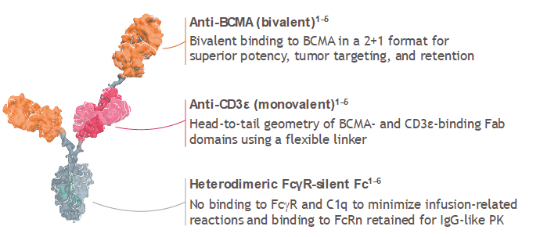
BCMA-targeted bispecific T-cell engager therapies: CC-93269
CC-93269^{3,4}
(BCMA “2+1”
× CD3ɛ)
Phase I
(Estimated enrollment N = 115)
Patient characteristics
N = 30
Median age, years: 64 (range 42-78)
Median prior lines of therapy: 5 (range 3-13)
Anti-CD38 Ab–refractory, n (%)‡ | 24 (80.0)
Triple-refractory, n (%) | 20 (66.7)
N=78
Safety
profile
Adverse event* | Any grade, n (%) | Grade ≥3,§ n (%)
CRS | 23 (76.7) | 1 (3.3)
Infections/infestations | 17 (56.7) | 9 (30.0)
Neutropenia | 14 (46.7) | 13 (43.3)
Anemia | 13 (43.3) | 11 (36.7)
Thrombocytopenia | 9 (30.0) | 5 (16.7)
Data as of October 28, 2019.
Efficacy
outcomes
 | 6 mg and 3 mg→6 mg (n = 14) | 10 mg and 6 mg→10 mg (n = 9)
ORR | 35.7% | 88.9%
sCR/CR | 7.1% | 44.4%
VGPR | 7.1% | 33.3%
PR | 21.4% | 11.1%
It is now in an expansion phase with SC administration
*Adverse events of any grade occurring in ≥30% of patients.^{2,4} †Best response in response-evaluable patients.² ‡PI-refractory, n (%): 23 (76.7); immunomodulatory agent refractory, n (%): 24 (80.0).^{4 §}Grade 5 TEAEs were reported in 4 patients, including CRS, sudden cardiac death, sepsis, and general physical health deterioration (n=1 each).⁴
Ab, antibody; BCMA, B-cell maturation antigen; CD, cluster of differentiation; CR, complete response; CRS, cytokine release syndrome; mDOR, median duration of response; mPFS, median progression-free survival; NR, not reported; ORR overall response rate; PI, proteasome inhibitor; PR, partial response; sCR, stringent complete response; TEAE, treatment-emergent adverse event; VGPR, very good partial response.
1. clinicaltrials.gov/ct2/show/NCT03145181. Accessed September 23, 2020; 2. Usmani SZ, et al. ASCO 2020. Abstract 100; 3. clinicaltrials.gov/ct2/show/NCT03486067. Accessed September 23, 2020; 4. Costa LJ et al. ASH 2019. Abstract 143.
Notes:
Congress presentation details:
Usmani SZ et al. Phase 1 study of teclistamab, a humanized B-cell maturation antigen (BCMA) x CD3 bispecific antibody, in relapsed or refractory multiple myeloma. Presented at: American Society of Clinical Oncology Annual Meeting; May 29-31, 2020; virtual format, USA. Presentation 100.
Costa LJ et al. First Clinical study of the B-Cell maturation antigen (BCMA) 2+1 T cell engager (TCE) CC-93269 in Patients (Pts) with Relapsed/Refractory Multiple Myeloma (RRMM): Interim Results of a Phase 1 Multicenter Trial. Presented at the Annual Meeting of the American Society of Hematology (ASH); December 7–10, 2019; Orlando, FL, USA. Abstract 143.
2. Usmani 2020/
Slide 5/c1/L1; c2/L1,8,9
1. NCT03145181/p1/Title; p2/Study description/Phase; Detailed description/L1; Study Design/Estimated enrollment
2. Usmani 2020/
Slide 7/c1/AE Table
2. Usmani 2020/
Slide 9/chart
3. NCT003486067/p2/Study description/Phase; Detailed description/L1; Study Design/Estimated enrollment
4. Costa ASH 2019/slide 2 Bullet 1
4. Costa ASH 2019/
Slides 5,6
4. Costa ASH 2019/
Slide 11
4. Costa ASH 2019/
Slide 7
2. Usmani 2020/
Slide 9/chart
4. Costa ASH 2019/
Slides 6, 7
2. Usmani 2020/
Slide 4/footer

Slide 127
Teclistamab, a BCMA×CD3 bispecific antibody, for patients with RRMM: Updated phase I results
Mechanism of action
BCMA
CD3
Teclistamab
Myeloma cell
T cell
Cell
death
T-cell
expansion
^{b}Glucocorticoid, antihistamine, and antipyretic; ^{d}One to 3 step-up doses given within 1 week before a full dose. BCMA, B-cell maturation antigen; IV, intravenous; SC, subcutaneous.
Garfall AL, et al. ASH 2020. Abstract 180.

Slide 128
MajesTEC-1: Phase I/II study of teclistamab, a BCMA×CD3 bispecific antibody, in RRMM – updated results
Baseline characteristics
Clinical response
 | Safety analysis (N = 165)
Age, median (range), years ≥75 years | 64.0 (33–84) 24 (15)
Male | 96 (58)
Race White African American/Black Other | 134 (81) 21 (13) 10 (6)
Bone marrow plasma cells ≥60% | 18 (11)
Extramedullary plasmacytomas ≥1 | 28 (17)
High-risk cytogenetics | 38 (26)
ISS stage I II III | 85 (53) 57 (35) 20 (12)
Data are n (%), unless stated otherwise
 | Safety analysis (N = 165)
Baseline renal function <60 mL/min/1.73m² ≥60 mL/min/1.73m² | 44 (27) 121 (73)
Time since diagnosis, median (range), years | 6.0 (0.8–22.7)
Prior lines of therapy, median (range), n | 5.0 (2–14)
Prior SCT | 135 (82)
Exposure status Triple-class exposed Penta-drug exposed Selinexor | 165 (100) 116 (70) 6 (4)
Refractory status Triple-class refractory Penta-drug refractory Refractory to last line of therapy | 128 (78) 50 (30) 148 (90)
Data are n (%), unless stated otherwise
ORR
62%
sCR
CR
VGPR
PR
Median follow-up:
7.8 months
Median time to first response: 1.2 mo
MRD negativity:
25% (10⁻⁵); 17% (10⁻⁶)
  42% in patients who had ≥CR
Teclistamab single agent update in the safety analysis cohort combining phase I and phase II expansion patients
78% triple-class refractory, 26% high-risk cytogenetics, 17% EMD
Moreau P, et al. ASH 2021. Abstract 896.

Slide 129
MajesTEC-1: Phase I/II study of teclistamab, a BCMA×CD3 bispecific antibody, in RRMM – updated results
ORR across subgroups
Safety (N = 165)
Subgroup | Subgroup | Patients (n) | ORR (95% CI)
Overall | Overall | 150
Age | <65 years 65–75 years ≥75 years | 75 52 23
Race | White Black Other | 134 6 10
Baseline ISS | I II III | 79 52 17
Baseline renal function | >60 mL/min/1.73 m² ≤60 mL/min/1.73 m² | 109 41
Baseline ECOG performance status | 0 ≥1 | 53 97
Cytogenetic risk | High risk Standard risk | 36 97
Extramedullary plasmacytomas | 0 ≥1 | 123 27
Prior lines of therapy | ≤3 >3 | 36 114
Refractory status | Triple class Penta drug | 116 44
AEs ≥20%, n (%) | Any Grade | Grade 3/4
Hematologic Neutropenia Anemia Thrombocytopenia Lymphopenia | 108 (65.5) 82 (49.7) 63 (38.2) 56 (33.9) | 94 (57.0) 57 (34.5) 35 (21.2) 53 (32.1)
Nonhematologic CRS Injection site erythema Fatigue Nausea Headache Diarrhea | 118 (71.5) 42 (25.5) 41 (24.8) 40 (24.2) 36 (21.8) 34 (20.6) | 1 (0.6) 0 (0) 3 (1.8) 1 (0.6) 1 (0.6) 4 (2.4)
Safety
Discontinuation due to an AE: 1 patient (adenoviral pneumonia)
SAEs: 88 patients (53.3%); teclistamab-related SAEs: 33 patients
Injection-site reactions: 58 patients (35.2%; all grade 1/2)
Infections: 104 patients (63%; grade 3/4: 35.2%)
Evidence of hypogammaglobulinemia: 119 patients (72.1%)
Deaths: 9 due to AEs; none related to teclistamab
0
25
50
75
100%
ORR sustained across different subgroups
Very few grade 3 or higher AEs including CRS
Moreau P, et al. ASH 2021. Abstract 896.

Slide 130
MagnetisMM-1: Phase I study of elranatamab (PF-06863135), a BCMA-targeted CD3-engaging bispecific molecule, for patients with RRMM
Study design
Prior treatments
1000 (N = 6)
 | N = 55
Number of prior therapies, median (range) | 6.0 (2–15)
Triple-class exposed, n (%) | 54 (98)
Triple-class refractory,ª n (%) | 50 (91)
Prior BCMA-targeted therapy, n (%) Anti-BCMA ADC CAR T | 12 (22) 7 (13) 9 (16)
ªRefractory to ≥1 PI, 1 IMiD, and 1 anti-CD38 mAb.
600 (N = 6)
Dose escalation
(Part 1, N = 30), μg/kg
360 (N = 4)
215 (N = 4)
130 (N = 4)
80 (N = 6)
Priming cohorts (Part 1.1, N = 20)
Priming dose 600 μg/kg → 1000 μg/kg (Q1W or Q2W)
Efficacy summary
Elranatamab 1000 μg/kg Q2W achieved exposure
associated with antimyeloma efficacy
Confirmed ORR was 69% (9/13) at the recommended dose of 1000 μg/kg Q1W
70% (7/10) of patients with prior BCMA-directed therapy achieved response
Expansion (Part 2A, N = 15)
Priming dose 44 mg → 76 mg (Q1W) Premedicationª
Heavily pretreated population
Good efficacy rates
Small study population
Data cutoff: July 26, 2021.
Sebag M, et al. ASH 2021. Abstract 895.

Slide 131
MagnetisMM-1: Phase I study of elranatamab (PF-06863135), a BCMA-targeted CD3-engaging bispecific molecule, for patients with RRMM
Treatment-emergent AEs (N = 55)
Effect of priming and premedication on CRS
AE, n (%) | Grade 1 | Grade 2 | Grade 3 | Grade 4 | Total
Hematologic Neutropenia Anemia Lymphopenia Thrombocytopenia Leukopenia | 0 2 (3.6) 0 6 (10.9) 2 (3.6) | 2 (3.6) 8 (14.5) 0 6 (10.9) 4 (7.3) | 13 (23.6) 25 (45.5) 3 (5.5) 5 (9.1) 9 (16.4) | 24 (43.6) 1 (1.8) 25 (45.5) 10 (18.2) 4 (7.3) | 39 (70.9) 36 (65.5) 28 (50.9) 27 (49.1) 19 (34.5)
Nonhematologic CRS Injection site reactions Fatigue Diarrhea Hypophosphatemia Decreased appetite Dry skin | 28 (50.9) 27 (49.1) 6 (10.9) 11 (20.0) 0 12 (21.8) 17 (30.9) | 20 (36.4) 4 (7.3) 12 (21.8) 7 (12.7) 6 (10.9) 6 (10.9) 2 (3.6) | 0 0 3 (5.5) 2 (3.6) 13 (23.6) 1 (1.8) 0 | 0 0 0 0 1 (1.8) 0 0 | 48 (87.3) 31 (56.4) 21 (38.2) 20 (36.4) 20 (36.4) 19 (34.5) 19 (34.5)
Occurring in ≥33% of patients.
 | Elranatamab SC at recommended monotherapy dose
 | Dose escalation Part 1 (N = 6) | Priming cohorts Part 1.1 (N = 20) | Expansion Part 2A (N = 15)
Priming/ Premedication | No/No | Yes/No | Yes/Yes
Overall incidence of CRS, n (%) Grade 1 Grade 2 | 6 (100) 4 (66.7) 2 (33.3) | 20 (100) 10 (50) 10 (50) | 10 (66.7) 5 (33.3) 5 (33.3)
Duration, days, median (range) | 4.0 (1–10) | 3.0 (2–7) | 3.0 (1–4)
Toxicity seems comparable
No further neurotoxicity/peripheral neuropathy
CRS seems well managed with 2-step dosing
Sebag M, et al. ASH 2021. Abstract 895.

Slide 132
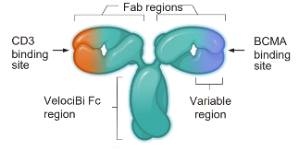
REGN5458, a BCMA×CD3 bispecific monoclonal antibody, in patients with RRMM
REGN5458 molecular structure
Study design
REGN5458 Phase I dosing schedule
REGN5458 IV dosing levels
Step-up dosing
DL6 96 mg (n = 8)
REGN5458
W1 dose(split)
REGN5458
W2 dose(split)
REGN5458 dose (single infusion)
DL5 48 mg (n = 7)
DL4 24 mg (n = 10)
W1D1
W2D1
Q2W doses after W16
DL3 12 mg (n = 10)
W1D2
W2D2
W3D1
DL2 6 mg (n = 10)
Part 2: dose expansion
DL1 3 mg (n = 4)
Part 1: dose escalation
A BCMA×CD3 bispecific antibody, discovered using VelociBi™
16 QW doses
RP2D
Four priming doses in the first 2 weeks before single infusion on W3 D1
Infusion every other week after 4 months: IV admin
75 pts after a median of 5PL: 19% TCR
Safety profile
CRS: 39% and no grade ≥3; not dose dependent; early onset and short duration
Neurotoxicity: Grade 1–2 in 4%; no grade 3–4
Neutropenia: Grade ≥3 in 14%; thrombocytopenia grade ≥3 in 6%
Infections: Any grade in 47%; grade ≥3 in 18%; mainly pneumonia and URTI
This is another BCMA-TCE mAb with IV administration
Similar toxicity, although the incidence of CRS as well as hematologic toxicity seems to be inferior to others
Infections are frequently reported
Madduri D, et al. ASH 2020. Abstract 291.

Slide 133
REGN5458, a BCMA×CD3 bispecific monoclonal antibody, in patients with RRMM
51% ORR for all enrolled patients
86% ≥VGPR and 43% ≥CR among all responders
For patients achieving CR/sCR (with available data), 4/10 negative at MRD 10⁻⁵
Time to response
  Median: <1 mo
  70% within first 2 mo
Estimated median DOR not reached
  Probability of EFS in responders at 8 mo: 90.2% (95% CI: 72.6-96.7)
Response, n (%) | DL 1-3 (n = 24) | DL 4-6 (n = 25) | DL 7-9 (n = 24)
ORR sCR CR VGPR PR | 29 13 13 0 7 | 48 20 4 24 0 | 75* 8 8 42 17
*Includes all patients who were evaluable for response assessment at 4 wk.
Madduri D, et al. ASH 2020. Abstract 291; Zonder J, et al. ASH 2021. Abstract 160.

Slide 134
TNB-383B, a BCMA×CD3 bispecific T-cell–redirecting antibody, in patients with RRMM: Initial results of a phase I study
TNB-383B molecular structure
Dose-escalation trial
Baseline characteristics
Cohort | Dose (mg q3w) | Enrolled
1 | 0.025 | 3
2 | 0.075 | 3
3 | 0.2 | 3
4 | 0.6 | 3
5 | 1.8 | 3
6 | 5.4 | 6
7 | 10 | 9
8 | 20 | 7
9 | 30 | 6
10a | 40 | 6
10b | 50 | 3
11 | 60 | 6
12+ | Up to +50%
αCD3
Bivalent αBCMA
IgG4 Fc
Fully-human triple-chain Ab with special features
Unique αCD3 moiety: minimal cytokine release
2 αBCMA domains: more specificity
Silenced IgG4 backbone: nonspecific T-cell activation, 2–3 week half-life
RP2D is 60 mg Q3W
Rodriguez C, et al. ASH 2020. Abstract 293; Kumar S, et al. ASH 2021. Abstract 900.

Slide 135
TNB-383B, a BCMA×CD3 bispecific T-cell–redirecting antibody, in patients with RRMM: Initial results of a phase I study
Clinical response
Safety profile
Although TNB-383B presents with some special features, safety and efficacy are in principle comparable with the others
No neurotoxicity has been reported so far
Advantages: fixed dose, no priming doses, and 48-hr hospitalization after the first dose
Administration every 3 weeks supported by the PK
Rodriguez C, et al. ASH 2020. Abstract 293; Kumar S, et al. ASH 2021. Abstract 900.

Slide 136
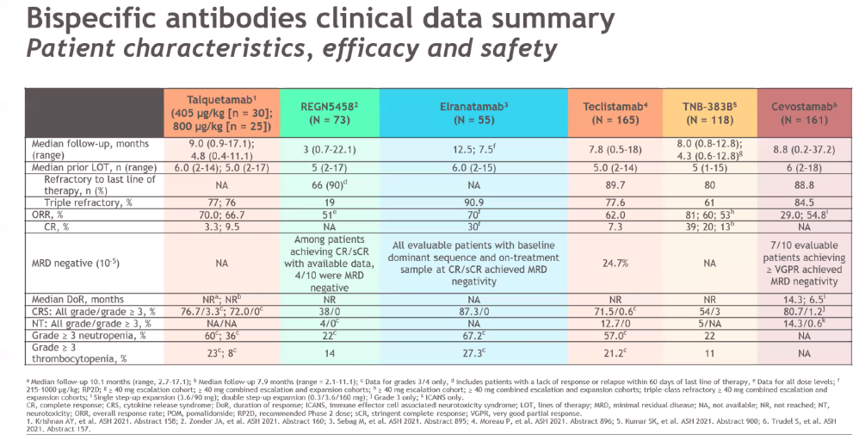
Bispecific mAbs in RRMM patients
Talquetamab and cevostamab targeting GPRC5D and FcRH5, respectively, included some patients previously exposed to BCMA-targeted therapy.
Follow-up is short and there are no mature data in PFS, DOR, or OS.

Slide 137
How are we going to differentiate them?
I don’t know how we will differentiate all of them
Efficacy, especially in terms of durability of response and PFS/OS, and these data are pending for most antibodies
Safety profile seems to be quite similar
Route of administration: IV vs SC
Schedule of administration: weekly vs every 2 weeks vs monthly
Priming dose: yes or no, and number of hospitalization days required
Would it be possible to use BsAbs after other BsAbs?
Are there other targets beyond BCMA?
BCMA, B-cell maturation antigen; IV, intravenous; OS, overall survival; PFS, progression free survival SC, subcutaneous.
Mateos MV. Personal perspective.

Slide 138
Clinical outcomes of RRMM following treatment with BsAbs
64 RRMM identified as relapsers after treatment with BsAbs
  7 prior lines
  89% TCR
  44% penta-refractory
Rescue therapies
  Second BsAbs (n = 20 pts, 33%) → 10 patients optimal response
  CAR T cells (n = 15 pts, 20%) → 8 patients optimal response
  Intensive chemo (n = 36, 59%)
  There are some other options beyond the bispecific mAbs, and we have to consider target and fitness of the T lymphocytes
Median PFS = 28.9 mo
Krishnan AY, et al. ASH 2021. Abstract 158.

Slide 139



Phase I study of talquetamab in RRMM: Updated results
To identify the RP2D of the GPRC5D×CD3 bispecific antibody talquetamab in patients with multiple myeloma who are relapsed/refractory to standard therapies including immunomodulatory drugs and proteasome inhibitors. Prior anti-BCMA therapy is allowed
Another RP2D: 800 µg/kg Q2W
76% triple-refractory and 16% exposed to anti-BCMA
Talquetamab at the RP2D of 405 μg/kg QW and 800 μg/kg Q2W SC was well-tolerated with encouraging efficacy; durable, deepening responses and delayed low-grade CRS were observed.
Future studies will investigate teclistamab in earlier lines of therapy, and in combinations.
AEs (any grade) at RP2D
ORR: 70%
60% grade 1
10% grade 2
3% grade 3
60% grade 3–4
At 800 µg/kg Q2W
ORR: 66.7% and 52.4% ≥VGPR
Similar safety profile
GPRC5d-related toxicity: skin exfoliation,
dysgeusia, site reaction, nail alterations . . .
Krishnan AY, et al. ASH 2021. Abstract 158.

Slide 140
BFCR4350A, cevostamab, a FcRH5/CD3 T-cell–engaging bispecific antibody, in patients with RRMM: Initial clinical activity
Key inclusion criteria
Cevostamab administration
RRMM for which no established therapy is available, appropriate, or tolerable
ECOG PS 0–1
Prior CAR Ts, ADCs, and bispecific antibodies allowed
Q3W intravenous infusions for 17 cycles*
CRS/infusion-related reaction mitigation
  C1 step-up dosing
  C1–2 corticosteroid premedication†; C1–17 acetaminophen and diphenhydramine premedication
Hospitalization (≥72 hours) after each C1 infusion
Patients with CRS in the single step-up and double step-up cohorts
160 pts after a median of 6PL
85% TCR
Prior BCMA was allowed (54 pts [33.8%])
28 pts (17.5%) prior CAR T
13 pts (8.1%) prior BsAb
27 pts (17%) prior ADC
Efficacy is dose dependent
36.1% in patients treated with 20- to 90-mg dose level
56.7% in patients treated with 132- to 198-mg dose level
Activity in patients previously exposed to BCMA: 36.4% ORR
- Post-CAR T (44,4), post-BsAb (33%), post-ADC (50%)
Trudel S, et al. ASH 2021. Abstract 157.

Slide 141
What should you know today about bispecifics mAbs?
  No age limit and pts >80 included in trials
  ECOG 0,1 and fit/moderately fit
  CrCl >40-45 mL/min
  No subgroup analysis
  Clinical trial
    Off the self
    Continuous therapy
Who is the candidate?
How to reach it?
  Strategies to mitigate CRS
    Priming dose and premed
  Cytopenias/infections
  Talquetamab: nail disorders, skin rash, dysgeusia
  Local site reactions mild
  Others: asthenia, headache, diarrhea . . .
  Step-up doses overall before full dose C1D1
  Require hospitalization 7-10 days
  IV/SC Q1W, Q2W, Q3W
  Until PD
Toxicity management
Delivery
Belantamab mafodotin single agent is effective in DOR but the ORR is 33%→ Available in all centers
BsAbs are off-the self drugs, effective choice for aggressive relapses or rapidly progressing MM patients→ Available in centers with experience in CRS management, and hematologists on call
CAR T cells would be the winners, but the road map is more complex
Mateos MV. Personal perspective.

Slide 142
How to proceed in clinical practice?
Data from BsAbs are encouraging and they cover the unmet medical need in TC-exposed/refractory MM patients
No mature information about PFS and OS to put in the context of other immunotherapies like ADC in combination or CAR T cells
I consider the median PFS will be around 12 months (????)
How to choose between ADC, BsAb, or CAR T, assuming the first indication would be similar?
The future for BsAbs is very promising because they are being combined with IMiDs, anti-CD38 mAbs, and even among themselves (Tec plus Tal), the priming doses and premedication will mitigate CRS, and the agents will be available in all centers after appropriate training
Mateos MV. Personal perspective.

Slide 143
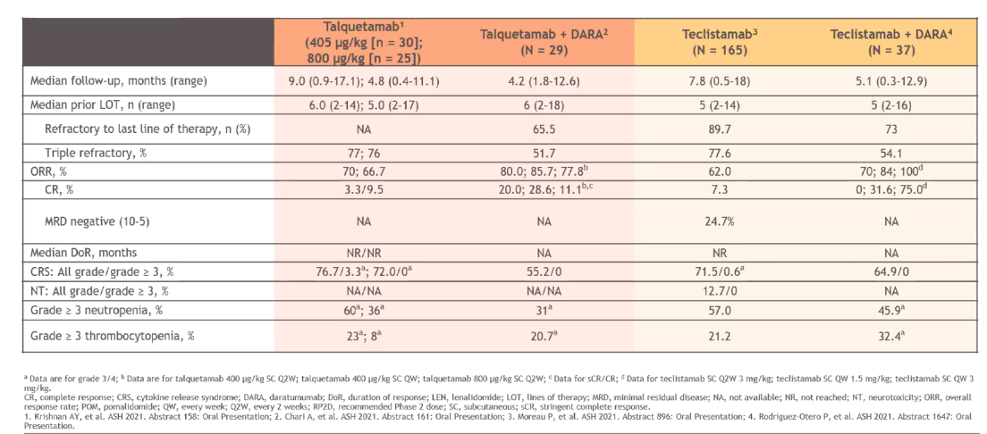
Bispecific mABs in RRMM patients: The future
Bispecific mAbs combine well with antiCD38 mAbs and it would also be possible to combine among them or with IMiD.
This potential synergistic effect will contribute to positioning them.
1. Krishnan A, et al. ASH 2021. Abstract 158; 2. Chari A, et al. ASH 2021. Abstract 161; 3. Moreau P, et al. ASH 2021. Abstract 896; Rodriguez-Otero P, et al. ASH 2021. Abstract 1647.

Slide 144
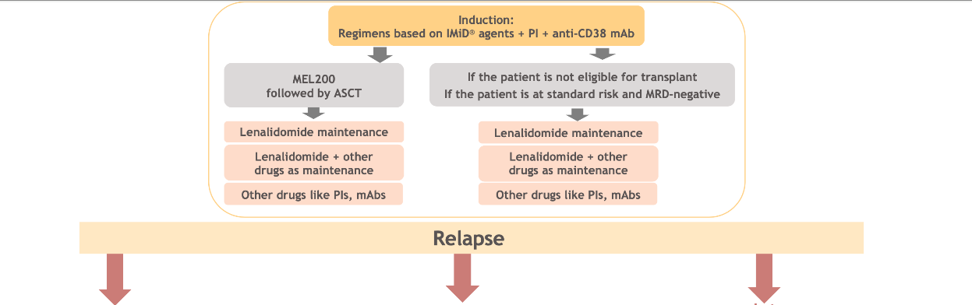
Future landscape for MM
Early relapses: functional HR
Intermediate relapses
Late relapses: 7-8 yr after 1L
BCMA CAR Ts
Bispecific mAbs plus SOC
Belamaf plus Pom-dex
CAR Ts
Bispecific mAbs plus SOC
Belamaf-SOC
Carfilzomib
Pomalidomide
CAR Ts
Bispecific mAbs plus SOC
Belamaf plus SOC
Mateos MV. Personal communication.

Slide 145

CAR Ts in Multiple Myeloma
Hermann Einsele, MD

Slide 146
Global Multiple Myeloma Academy
Latest Trial Updates and Upcoming New Strategies; Focus on BCMA-Directed Therapies
19 March 2022
Prof Dr Hermann Einsele
Medizinische Klinik und Poliklinik II
Universitätsklinikum Würzburg

Slide 147
Unmet Medical Need:
Poor Outcomes in Patients Refractory to PI/IMiDs and CD38 mAbs
275 MM patients refractory to anti-CD38 mAbs
mOS from refractoriness to CD38
  All patients: 8.6 months
  “Non-triple refractory”: 11.2 months
  “Triple and quad refractory”: 9.2 months
  “Penta-refractory”: 5.6 months
249 patients received further treatment
  mPFS: 3.4 months
  mOS: 9.3 months
OS according to refractoriness
1.0
0.8
0.6
Proportion surviving
0.4
Not triple refractory (n = 57)
Triple and quad
refractory (n = 148)
0.2
P = .002
Penta-refractory (n = 70)
0
0
10
20
30
40
50
New treatments urgently needed!
Time (months)
Gandhi UH, et al. Leukemia. 2019;33:2266-2275.

Slide 148
What is the main target for CAR T-cell therapy for patients with multiple myeloma?
?
  CD38
  CD138
  SLAMF7/CS1
  GPRC5D
  BCMA

Slide 149
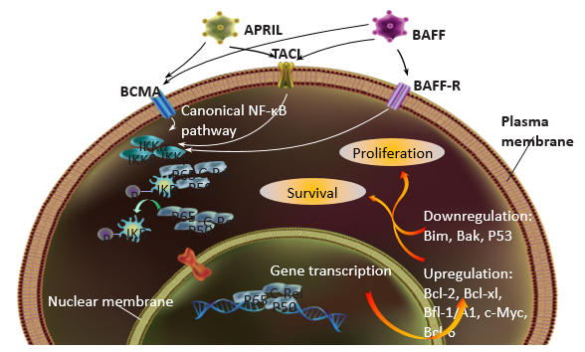
The Target: BCMA (B-cell maturation antigen)
BCMA is a member of the TNF receptor superfamily and is highly restricted to plasma cells
Interaction of BCMA with APRIL
BAFF induces activation of MAPK pathway
NF-κB → promote proliferation/survival
Highly expressed on MM cells at relatively high levels
Region Name | No. of BCMA CAR T-Cell Trials
World | 63
East Asia | 42
Europe | 4
North America | 20
Non-BCMA CART MM | 9
Studies with multiple locations are included and represented by each region.
Einsele H. Personal communication; Clinical trials with BCMA CAR T cells. clinicaltrials.gov. Jan 2022.

Slide 150
BCMA CAR T-Cell Therapy: KarMMa Study – Idecabtagene Vicleucel (ABECMA; ide-cel; bb2121) Approved by FDA/EMA 2021
Open-label, single-arm study; N = 140
≥3 prior therapies (including an IMiD, a PI, and an anti-CD38 antibody); median: 6 lines of prior therapy
94% of patients refractory to anti-CD38 antibody; 84% triple refractory, EMD: 39%
Median follow-up: 11.3 months
Efficacy
 | Ide-Cel Treated Population
 | 150 × 10⁶ CAR+ T cells (N = 4) | 300 × 10⁶ CAR+ T cells (N = 70) | 450 × 10⁶ CAR+ T cells (N = 54) | 150–450 × 10⁶ CAR+ T cells (N = 128)
ORR, n (%) | 2 (50.0) | 48 (68.6) | 44 (81.5) | 94 (73.4)
CR/sCR, n (%) | 1 (25.0) | 20 (28.6) | 19 (35.2) | 40 (31.3)
Median DOR, months | --- | 9.9 | 11.3 | 10.6
Median PFS, months | --- | 5.8 | 11.3 | 8.6
Median DOR and median PFS are not reported for the 150 × 10⁶ CAR+ T cells dose group due to the small number of evaluable patients.
Grade ≥3 CRS: 5.5%
Grade ≥3 investigator-identified neurotoxicity events: 3.1%
In the subgroup of patients achieving a CR: PFS >20 months
Bristol-Myers Squibb and bluebird bio [press release]. Dec 6, 2019.

Slide 151


Cilta-Cel: CAR T-Cell Product Targeting BCMA With 2 Target Domains
BCMA-Directed CAR T-Cell Therapy With Cilta-Cel²
BCMA, B-cell maturation antigen.¹
1. iNEWS. March 10, 2022. https://inf.news/en/health/6df54fb26a83f3da954bf0c461c420ea.html; 2. Jakubowiak A, et al. ASH 2021. Abstract 3938.

Slide 152


Updated Results From CARTITUDE-1: Phase Ib/II Study of Ciltacabtagene Autoleucel, a B-Cell Maturation Antigen-Directed Chimeric Antigen Receptor
Cell Therapy, in Patients With Relapsed/Refractory Multiple Myeloma
ORR
OS
Martin T, et al. Blood. 2021;138(suppl 1): abstract 549.

Slide 153
Are there subgroups of MM patients who respond less favorably to CAR T-cell therapy?
?
  Newly diagnosed MM patients
  Patients with renal dysfunction
  Patients with EMD
  Patients in sCR prior to CAR T-cell therapy
  Patients with ISS stage III

Slide 154

CARTITUDE-1
CAR T-Cell Therapy | Subgroup Analysis
Jakubowiak A, et al. ASH 2021. Abstract 3938.
Notes:
Results: As of February 11, 2021, 97 pts in the overall population received cilta-cel; 58.8% were male, median age was 61 years (range 43–78), and median time from diagnosis to enrollment was 5.9 years (range 1.6–18.2). ORR across all evaluated subgroups was comparable to the overall population, and was consistently high (range 95.1–100%) including in those with high-risk cytogenetics, ISS stage III MM, baseline bone marrow cells ≥60%, and baseline plasmacytomas (Table). Median DOR for most subgroups, including high-risk cytogenetics, was consistent with the overall population or not reached but was shorter in pts with ISS Stage III MM and baseline plasmacytomas (Table). Across all subgroups, 80%–100% of MRD-evaluable pts achieved MRD negativity (10⁻⁵ threshold). 18-month PFS and OS rates were consistent with the overall population in most subgroups, including high-risk cytogenetics, and lower in ISS stage III and baseline plasmacytomas (Table). Incidence of CRS, ICANS, and other CAR T-cell neurotoxicities (events not reported as ICANS [ie, onset after a period of recovery from CRS and ICANS]) in various subgroups was consistent with the overall population, with no new safety signals.

Slide 155

Fitness of T cells
How to Increase CAR T-Cell Fitness/Efficacy/Persistence?
Generate CAR T Cells in Earlier Lines of Therapy
Dancy E, et al. Blood. 2018;132: abstract 1886.

Slide 156



CARTITUDE-2: Efficacy and Safety of Ciltacabtagene Autoleucel, a B-Cell Maturation Antigen (BCMA)-Directed Chimeric Antigen Receptor T-Cell Therapy, in Patients With Multiple Myeloma and Early Relapse After Initial Therapy
“Early relapse” after initial therapy with PI and IMiD; defined as progression within 12 months after ASCT or within 12 months from start of anti-MM therapy for patients who have not had an ASCT
Van de Donk NWCJ, et al. Blood. 2021;138(suppl 1): abstract 2910.
Notes:
Introduction: Patients (pts) with multiple myeloma (MM) who experience early clinical relapse, defined as disease progression ≤12 mo after autologous stem cell transplantation (ASCT) or start of initial treatment (tx), have median overall survival rates <2 y despite tx with novel agents such as proteasome inhibitors (PI), immunomodulatory drugs (IMiDs), and monoclonal antibodies. Ciltacabtagene autoleucel (cilta-cel) is a chimeric antigen receptor (CAR) T-cell therapy with 2 BCMA-targeting single-domain antibodies. In the phase 1b/2 CARTITUDE-1 study, cilta-cel demonstrated deep and durable responses in heavily pretreated pts with relapsed/refractory MM (Berdeja, Lancet, 2021). The phase 2, multicohort CARTITUDE-2 study (NCT4133636) is evaluating the safety and efficacy of cilta-cel in pts with MM in various disease settings. Here, we present the first results from cohort B of CARTITUDE-2, which enrolled pts following early relapse after initial therapy that included a PI and IMiD.
Methods: Eligible pts had MM, received 1 prior line of therapy (PI and IMiD required), had disease progression per IMWG criteria (either ≤12 mo after ASCT or ≤12 mo after start of anti-myeloma therapy for pts who did not undergo ASCT), and were tx-naïve to CAR-T or anti-BCMA therapies. A single cilta-cel infusion (target dose 0.75×10⁶ CAR+ viable T cells/kg) was given 5–7 d after start of lymphodepletion (300 mg/m² cyclophosphamide and 30 mg/m² fludarabine daily for 3 d). The primary objective was minimal residual disease (MRD) negativity at 10⁻⁵, as assessed by next generation sequencing. Adverse events (AEs) were graded using CTCAE v5.0 (cytokine release syndrome [CRS]) and immune effector cell associated neurotoxicity syndrome (ICANS) by ASTCT criteria. To minimize risk of movement and neurocognitive tx-emergent AEs (TEAEs), pt management strategy was implemented, consisting of enhanced bridging therapy to reduce baseline tumor burden, early aggressive tx of CRS and ICANS, and handwriting assessment tools for early detection of neurotoxicity symptoms.
Results: As of the April 15, 2021, data cutoff, 18 pts (median age 57.0 y [range 44–67]; 78% male) received cilta-cel, and 2 pts died before cilta-cel infusion (1 each due to progressive disease and worsening general status). Median follow-up was 4.7 mo (range 0.6–13.5); median time from diagnosis to enrollment was 1.1 y (range 0.5–1.9). Two (11.1%) pts had high cytogenetic risk and 5 (27.8%) had bone marrow plasma cells >30%; 14 (77.8%) pts received prior ASCT, and 15 (83.3%) were refractory to their prior therapy. Overall response rate was 88.9% (95% CI: 65.3–98.6), 27.8% of pts (95% CI: 9.7–53.5) achieved ≥complete response (CR), and 66.7% (95% CI: 41.0–86.7) achieved ≥very good partial response (VGPR). Median time to first response was 0.9 mo (range 0.9–2.6), median time to best response was 1.4 mo (range 0.9–11.8), and median time to ≥CR was 1.8 mo (range 0.9–11.6). Of the 13 pts with ≥3 mo follow up, 5 (38%) achieved ≥CR. Of pts who were MRD-evaluable (n=9), all were MRD 10⁻⁵ negative (100% [95% CI: 66.4–100]). At data cutoff, all but 1 pt remained in clinical response (Figure). Hematologic TEAEs in ≥20% of pts were neutropenia (88.9%), thrombocytopenia (61.1%), anemia (50.0%), leukopenia (27.8%), and lymphopenia (22.2%). CRS occurred in 15 (83.3%) pts (1 gr 4); median time to onset was 8 d (range 5­–11), consistent with the heavily pretreated pts in the CARTITUDE-1 study. Median duration of CRS was 4 d (range 1–7). ICANS (gr 1) occurred in 1 pt. One pt experienced movement and neurocognitive TEAEs (gr 3) on Day 38 post cilta-cel infusion. This pt had high disease burden at baseline, progressive disease despite triplet bridging therapy, and gr 4 CRS which have been identified as risk factors for movement and neurocognitive TEAEs. The pt was treated with immune-directed measures and was reported to be stable with some improvements at data cutoff and achieved VGPR. No study deaths occurred post cilta-cel infusion.
Conclusions: A single cilta-cel infusion led to early and deep responses in pts who experienced early clinical relapse/tx failure to initial therapy, with a manageable safety profile. MRD negativity was achieved early. Responses continue to deepen, and follow-up is ongoing, including MRD assessment. These findings support the continued exploration of cilta-cel in earlier lines of treatment and incorporation into potentially curative front-line regimens.

Slide 157

Randomized Phase III Study in Newly
Diagnosed, Transplant-Eligible Patients vs ASCT
EMN28
Key eligibility criteria
Newly diagnosed patients
  Age ≤70
  Eligible for initial ASCT
Sample size: ~750
scDara + VRd (×4) then ASCT, then
D-VRd consolidation (×2), then D + R maintenance* (until PD)
Follow-up until PD
Long-term follow-up for survival, subseq. therapies, and SPMs
D + VRd
6 cycles
Cilta-cel
D + R
(max 2 yr)
Observation
1:1 Randomization
Assessment of PFS
Stratification factors:
ISS staging
Cytogenetics
Age
*On the basis of DARA-MMY3014 registration study. Includes DARA-stopping rules after 2 years for MRD negativity.
Primary endpoint:
Sustained MRD– CR
Key secondary endpoint: PFS
ClinicalTrials.gov identifier: NCT05257083.

Slide 158


How to Improve Persistence of CAR T Cells? bb21217: Next-Generation Anti-BCMA CAR T-Cell Therapy Product for Multiple Myeloma
bb21217 is cultured with PI3 kinase inhibitor, bb007, to enrich for T cells displaying a memory-like phenotype
CAR T cells enriched for this phenotype may persist and function longer than non-enriched CAR T cells
BCMA-CAR T: limited persistence
CAR T-cell persistence over time
Terminally Differentiated
No Self-Renewal
Short Lived
Raje N, et al. N Engl J Med. 2019;380:1726-1737.
Berdeja JG, et al. ASH 2019. Abstract 927.

Slide 159


Updated Clinical and Correlative Results From the Phase I CRB-402 Study of the BCMA-Targeted CAR T-Cell Therapy bb21217 in Patients With Relapsed and Refractory Multiple Myeloma
ORR
CRS and Neurotoxicity
Patient characteristics:
Number of prior regimens: Median 6 (3–17)
High-risk cytogenetics: 39%
Extramedullary disease: 22%
R-ISS III: 18%
Raje N, et al. Blood. 2021;138(suppl 1): abstract 548.

Slide 160




A Remote Control for CAR T Cells?!
Goal:
Rapid and tight control of CAR T-cell activity without elimination of the CAR T cells
“PAUSE” function – transient stop of function
Prevent exhaustion and prolong persistence!
Step 1: “PAUSE” function
CAR T cell

Slide 161

CAR T-Cell Signaling Depends on Tyrosine Kinases
TKI
(Dasatinib)
Inhibits Lck phosphorylation and NFAT induction
Maus MV, Levine BL. Oncologist. 2016;21:608-617.

Slide 162


The TKI Dasatinib Switches CAR T Cells OFF In Vitro
Untreated
12.5 nM
25 nM
50 nM
100 nM
Dasatinib exerts superior control over CAR T than dexamethasone.
Dasatinib blockade is reversible; no decrease in CAR T count/viability.
Mestermann K, et al. Sci Transl Med. 2019;11:eeaau5907.
162

Slide 163

Dasatinib Prevents the Development of Severe CRS
→ Dasatinib rescues mice from fatal CRS/no rebound after drug discontinuation
Mestermann K, et al. Sci Transl Med. 2019;11:eeaau5907.
163

Slide 164

Superior Anti-lymphoma Effect After ON/OFF/ON Sequence
Dasatinib treatment post-CAR19
T-cell infusion
→ ↑ Anti-lymphoma activity
→ Use of prophylactic dasatinib
→ ↓CRS/ICANS and
→ ↓CAR T-cell exhaustion
→ ↑ CAR T-cell persistence
→ Dasatinib prevents AICD and CAR T-cell exhaustion
Mestermann K, et al. Sci Transl Med. 2019;11:eeaau5907.

Slide 165


Anti-BCMA ALLO-715 and Anti-CD52 ALLO-647
First allogeneic BCMA CAR T-cell study in RRMM
Phase I, open-label, multicenter dose-escalation study
Primary endpoints: safety and tolerability
Secondary endpoints
ALLO-715 P2 dose and lymphodepletion regimen
ORR, DOR, PFS, and MRD
Cellular kinetics and PK
Median age 65 years
Heavily pretreated patients (94% penta-exposed)
~90% of patients treated within 5 days of enrollment
No bridging therapy required
BCMA, B-cell maturation antigen; CAR, chimeric antigen receptor; DOR, duration of response; GvHD, graft-vs-host disease; MRD, minimal residual disease; ORR, overall response rate; PFS, progression-free survival; ScFv, single-chain variable fragment; TCR, T-cell receptor.
Mailankody S, et al. ASH 2020. Abstract 129 (oral presentation).
Notes:
Mailankody S et al. Universal: An Allogeneic First-in-Human Study of the Anti-Bcma ALLO-715 and the Anti-CD52 ALLO-647 in Relapsed/Refractory Multiple Myeloma. ASH 2020: Abstract 129.
Background
Allogeneic (off the shelf) chimeric antigen receptor (CAR) T cell therapy addresses the logistical challenges, availability and variable product quality of autologous CAR T therapy. ALLO-715 is a genetically modified anti-BCMA AlloCAR T^{tm} cell product in which the TCR alpha constant gene is disrupted to reduce the risk of graft-versus-host disease (GvHD) and the CD52 gene is disrupted with Talen® technology to permit the use of ALLO-647, an anti-CD52 mAb, for selective and prolonged host lymphodepletion (LD).
Methods
This is an open-label, Phase 1 trial (NCT04093596) in adults with R/R multiple myeloma who have received ≥3 prior lines of therapy including a proteasome inhibitor, immunomodulator, and anti-CD38 mAb. Patients (pts) must be refractory to their last treatment line. Patients receive LD followed by ALLO-715 at 1 of 4 dose levels (DL) in a 3+3 dose escalation design: 40, 160, 320, and 480 x 10⁶ CAR+ T cells. Several LD regimens are being evaluated. These include: FCA (fludarabine (F) 90 mg/m², cyclophosphamide (C) 900 mg/m², and ALLO-647 (A) 39 mg divided over 3 days), FCA+ (same F and C but ALLO-647 (A+) dose of 90 mg divided over 3 days); as well as CA (same C and A divided over 3 days, but no F given).
Results
As of 08 July 2020, 19 pts had enrolled and 15 had received ALLO-715 at 3 DLs: 3 pts at DL1 (3 FCA and 0 CA); 7 pts at DL2 (4 FCA and 3 CA); 5 pts at DL3 (3 FCA and 2 CA). As of the data cutoff, no pts had received FCA+ or ALLO-715 DL4. Patients were heavily pre-treated and in advanced stage of disease with a median of 5 (range 3-11) prior lines of therapy and 31.6% ISS Stage III at screening. All but 1 had a prior autologous stem cell transplant. 52.6% (10/19) of patients had high risk cytogenetics, and 26.3% (5/19) had extramedullary disease. The most common Grade ≥3 adverse events were anemia (41.2%), neutropenia (41.2%), lymphopenia (29.4%), and thrombocytopenia (29.4%). Four episodes of Grade ≥3 infections occurred in 4 pts. Three of these were Grade 3 and included parvovirus B19, staphylococcal bacteremia, and pneumonia, which resolved with treatment. The fourth was a Grade 5 episode that occurred on day 8 post-ALLO-715 infusion in a rapidly progressing, refractory myeloma pt who, on day 1, developed a non-neutropenic fever and multifocal pneumonia with negative blood and sputum cultures. The patient progressed to respiratory failure and only comfort care was pursued. This death was considered related to conditioning (CA). No DLTs to ALLO-715 had been reported as of the data cutoff. In addition, no neurotoxicity (ICANS) or GvHD had been reported as of the data cutoff. Cytokine release syndrome was reported in 4 pts (24%). Three episodes were Grade 1 and 1 was Grade 2 (Lee Grading); all resolved without tocilizumab or corticosteroids. Fifteen pts were efficacy evaluable (defined as receiving ALLO-715, and undergoing at least one response assessment or discontinuing prior to the first response assessment), with a median follow-up of 2 months (range 0, 10 months). A higher dose of ALLO-715 (DL3) was associated with greater anti-cancer activity with 3/5 pts responding per IMWG (60%, 95% CI 14.7, 94.7). In pts who received DL3 FCA, 2/3 responded (1 sCR and 1 VGPR, Table 1). All DL3 pts who responded experienced at least a VGPR and achieved MRD negative status by local MRD testing. All responses were initially observed at day 14. Four (80%) out of the 5 responders were still in response at the time of the data cutoff. ALLO-715 cell expansion by qPCR was observed at all dose levels.
Conclusions
These early data suggest that ALLO-715 and ALLO-647 have a manageable safety profile. ALLO-715 shows evidence of clinical activity in the allogeneic setting in pts with R/R multiple myeloma and suggests that higher cell doses are associated with greater anti-cancer activity. Enrollment is ongoing in cohorts with higher ALLO-715 (480M CAR+ T-cells) and ALLO-647 (90mg). Updated safety, efficacy, PK/PD data will be presented. Clinical trial information: NCT04093596.

Slide 166




Anti-BCMA ALLO-715 and Anti-CD52 ALLO-647
Manageable safety profile
Efficacy outcomes
5 of 6 VGPR+ patients were MRD–
ORR cell dose dependent
Improved expansion occurred in patients who received higher cell doses
Tumor response to treatment
Well tolerated across all dose levels
No GvHD or neurotoxicity
Manageable grade 1 or 2 CRS
Infection rate similar to other studies in advanced MM
Average VCN by dose level
Mailankody S, et al. ASH 2020. Abstract 129 (oral presentation).

Slide 167

Increase Target Antigen Expression to Improve Efficacy of CAR T Cells
Gamma secretase inhibitors (GSI) increase the BCMA antigen expression on MM cells, reduce the level of soluble BCMA, and increase the efficacy of BCMA CAR T cells in a mouse model
Here: Dose-escalation study of BCMA CAR T cells + GSI (3×/week) in patients with RRMM
Cowan AJ, et al. ASH 2021. Abstract 551.
Notes:
Results:
From June 2018 to March 2021, 18 patients underwent leukapheresis, run-in with JSMD194, and treatment with BCMA CAR T cells. The median age was 65 years, and patients had received a median of 10 prior lines of therapy (range, 4-19). 67% of patients were refractory to lenalidomide, pomalidomide, bortezomib, carfilzomib, and daratumumab, 72% had high-risk cytogenetic features, and 28% had extramedullary disease. 7/18 (39%) had prior BCMA targeted therapy; other BCMA targeted CAR T cell products had previously been administered to 4/18 patients (22%). All 18 treated patients completed the 5-day run-in with JSMD194. After three oral doses of GSI, increased from a median of 610 to 9563 receptors per cell, or a median of 12-fold (range, 0.2-fold to 157-fold; Figure 1). The only patient that did not demonstrate an increase in BCMA ABC after GSI run-in had previously received BCMA targeted therapy and BCMA expression at screening was virtually absent. 5 patients were treated at 5x10⁷ CAR+ cells, 3 were treated at 15x10⁷ CAR+ cells, 3 were treated at 30x10⁷ CAR+ cells, and 7 were treated at 45x10⁷ CAR+ cells dose levels. Treatment was consistent with other BCMA CAR T therapy, with manageable toxicities. One patient experienced a DLT. 95% of patients experienced cytokine release syndrome (CRS), mostly grade 1-2 (83%), and 66% of patients experienced ICANS, predominantly grades 1-2. The overall response rate was 89%, with 14 patients achieving ≥ VGPR, and 8 patients achieving CR (including 5 with sCR). Deep responses were observed at all dose levels; including the first patient treated on trial at (dose level 1) who has maintained a stringent CR (sCR) for over 35 months and 3 of 5 patients at dose level 1 had no evidence of progressive disease for >18 months. With a median follow-up of 20 months, the median PFS is 11 months (95% CI, 6 mos to not reached). Amongst patients without prior exposure to BCMA targeted therapy (n=11), the median PFS has not been reached, while amongst those previously exposed to BCMA targeted therapy (n=7), the median PFS was 2 months.

Slide 168


Irreversible Loss of BCMA Expression
Whole genome sequencing
Da Via MC, et al. Nat Med. 2021;27:616-619; Asmann Y, et al. ASH 2021. Abstract 3838.

Slide 169



Antigen Escape in BCMA CAR T-Cell Therapy for MM
Antigen escape is a common mechanism of escape after CART19 in particular in ALL (40-75%), but also in DLBCL (~30%)
HOMOZYGOUS BCMA LOSS IN RESPONSE TO T-CELL ENGAGERS (TCE)
Truger MS, et al. Blood Adv. 2021;5:3794-3798.
Asmann Y, et al. ASH 2021. Abstract 3838.

Slide 170
1590 – 16p Deletion Involving BCMA Locus Is Frequent and Predominantly Observed With Del17p
Mehmet K. Samur, et al. Boston, USA
CAR T-Cell Therapy | Results
Newly Diagnosed Patients (n = 2458)
Del16p (monoallelic) | 8.58% (7.6%-14.6% depending on the study )
Relapsed MM patients without BCMA therapy | Similar to newly diagnosed MM
Copy number alterations in patients with BMCA loss HMM (hyperdiploid) Non-HMM (non-hyperdiploid) | → Independent of MM cytogenetic subtypes
Increased mutation-load With BMCA loss Without BMCA loss | 8202 (6921-9535) 6975 (6626-7343)
Del1p and del17p loss | → BMCA loss ↑
BCMA and TP53 loss | → 95% of the BCMA-losing cells also had a loss of p53
Samur MK, et al. ASH 2021. Abstract 1590.
Notes:
We first evaluated the frequency of deletion involving the BCMA locus (16p13.13) in MM patients from multiple studies using WGS sequencing data as well as using Affymetrix Cytoscan HD and SNP 6.0 arrays. We observed del16p in 8.58 % (7.6% to 14.6% in individual studies) of newly-diagnosed patients (n=2458). Similar frequency was observed in relapsed MM patients not previously exposed to BCMA targeting therapy. Next, we evaluated genome wide copy number alterations (CNAs) in all patients with loss of BCMA locus and observed similar frequency of loss in both hyperdiploid MM (HMM) and non-HMM suggesting its independence from cytogentic subtypes of MM. Overall copy number loss was significantly higher in patients with BCMA loss compared to rest of the MM patients. Patients with loss of BCMA locus have increased mutational load (8202 with 95% HDI 6921 and 9535) compared to those without BCMA locus loss (6975 with 95% HDI 6626 – 7343); probability of difference greater than 0 was 96.8% and difference of the means were 1222 [95% CI -112 - 2589]
We next evaluated co-occurrence of BCMA loss with other high risk events and observed del1p and del17p as being significantly associated with loss of BCMA locus [Odds ratio 19.37 (13.13-25.80), FDR = 1.57e-65; and 8.8 (6.39-12.15), FDR = 5.57E-39, respectively)]. Furthermore, we observed that when both BCMA and TP53 loss are present, they have same log ratio (sequencing) or smoothed copy numbers (SNP array). Similarly, we used CDKN2C as a proxy to chromosome 1p loss and observed that when both BCMA and CKDN2C loss are present in the same patient they tend to show similar copy number values. These data suggested a possibility of co-occurrence of these events in the same cell.
To further investigate this observation, we used single cell DNA sequencing data from patients with sub clonal and clonal BCMA locus loss. scDNA sequencing showed that almost all cells with BCMA deletion also had TP53 deletion (95%). Interestingly, almost all cells with BCMA loss also had p53 loss, while not all cells with p53 loss had BCMA loss suggesting that the chronology of this copy number alternation may suggest first p53 loss followed by BCMA loss. We further investigated whether a bi-allelic BCMA loss was observed after anti-BCMA targeted CAR-T cell therapy by imputing the copy number alterations using single cell RNA sequencing data. Our data from this case also indicated that BCMA loss tend to co-occur with TP53 deletions (OR=5.67 [95% CI 4.12-7.84], p value < 0.0001). Moreover, TP53 mutations were also more frequent in patients with del16p and del17p, compared to patients who only had del16p or del17p.

Slide 171

CAR T-Cell Therapy in Multiple Myeloma
T cell
CD19
EBV
GPRC5D
Tumor cell
EBV
SLAMF7
CD229
T cell
Einsele H. Personal communication.

Slide 172




New Target on the “Horizon2020”:
CARAMBA – Clinical Trial With SLAMF7 CAR T Cells in Myeloma
SLAMF7 uniformly expressed on myeloma cells; virus-free gene transfer of SLAMF7 CAR
CAR T generation in a few days
CARAMBA: Phase I/IIa study with SLAMF7 CAR T cells in multiple myeloma
Clinical centers Würzburg (GER), Milano (ITA), Lille (FRA), Pamplona (ESP)
https://www.caramba-cart.eu/
Prommersberger S, et al. Gene Ther. 2021;28(9):560-571.
Notes:
172

Slide 173
Phase I First-in-Class Trial of MCARH109, a G Protein-Coupled Receptor Class C Group 5 Member D (GPRC5D) Targeted CAR T-Cell Therapy in Patients With Relapsed or Refractory Multiple Myeloma
 | 25 × 10⁵ CAR+ T cells (n = 3) | 50 × 10⁵ CAR+ T cells (n = 3) | 150 × 10⁵ CAR+ T cells (n = 3) | 450 × 10⁵ CAR+ T cells (n = 3) | Total (n = 16)
Response
Minimal response or better, n (%) | 2 (67) | 3 (100) | 3 (60) | 5 (100) | 13 (81)
Partial response or better, n (%) | 1 (33) | 3 (100) | 2 (40) | 5 (100) | 11 (69)
Very good partial responses or better, n (%) | 1 (33) | 2 (67) | 0 (0) | 4 (80) | 4 (44)
Complete response or better, n (%) | 0 (0) | 1 (33) | 0 (0) | 3 (60) | 4 (25)
BM MRD negativity, n (%) | 2 (67) | 2 (67) | 2 (40) | 2 (50) | 8 (50)
 | Prior BCMA Therapy (n = 10) | Prior CAR T Therapy (n = 8)
Partial response or better, n (%) | 8 (50) | 6 (75)
Complete response or better, n (%) | 3 (30) | 3 (38)
BM MRD negativity, n (%) | 5 (50) | 2 (25)
Mailankody S, et al. Blood. 2021;138(suppl 1): abstract 827.

Slide 174
Conclusions
The first CAR T-cell product targeting BCMA was approved in the US/EU (ABECMA; ide-cel) in 2021 and a second BCMA CAR T-cell product (cilta-cel) will be approved for RRMM, probably in 2022
CAR T-cell therapy can induce ORR up to 100% and CR beyond 80% in patients with RRMM (with a median 6 lines of prior therapy) and PFS >2 years
In the Future
CAR T therapy will potentially become a part of first-line therapy for ultra/high-risk patients
CAR T therapy will challenge ASCT in TE NDMM
CAR T therapy for earlier lines of therapy also in non–transplant-eligible patients (low rate of grade >3 CRS/ICANS)

Slide 175


Many thanks for your attention!

Slide 176
Discussion

Slide 177
Relapsed/Refractory Multiple Myeloma Case Discussion

Slide 178
Patient Case 1 :
Relapsed/Refractory Multiple Myeloma
Borja Puertas Martínez, MD

Slide 179



Young Patient With Relapsed/Refractory Multiple Myeloma
Borja Puertas
Resident of Hematology
University Hospital of Salamanca

Slide 180


Case Presentation
47 years old
Multiple myeloma
MM IgG kappa diagnosed in August 2012, 4.4 g/dL of paraprotein, with lytic lesions as a CRAB, ISS-1, with 51% pathologic plasma cell in bone marrow, with no HR CA detected
Aug/12: Bortezomib + dexamethasone (×6) → PR → ASCT (Feb/13) → CR with negative MRD (+100 postASCT). No maintenance because it was not SOC
Dec/14–Jan/18: Lenalidomide + dexamethasone (×37) → VGPR
Jan/18–Aug/18: Daratumumab + bortezomib + dexamethasone (×8)→ PR
Oct/18–Feb/21: Carfilzomib + lenalidomide + dexamethasone (×17) → PR
ASCT, autologous stem cell transplant; CR, complete response; HR, hazard ratio; IgG, immunoglobulin; ISS-1, International Staging System-1; MM, multiple myeloma; MRD, minimal residual disease; PR, partial response; SOC, standard of care; VGPR, very good partial response.

Slide 181




Case Presentation
The patient was referred to our hospital for evaluation in order to be included in a clinical trial because of disease progression
Paraprotein: 1.76 g/dL
FLC kappa: 38.2 mg/L
K/L ratio: 18
Bence Jones proteinuria: 0.100 g/24h
Calcium and kidney function: normal
Blood count: Hb 8.4 g/dL l Platelets 33.000/µL l ANC normal
B symptoms (fever)
Disabling bone pain
Bone marrow aspiration: 88% PPC
Flow cytometry: 50.5% PPC
FISH: 1q gain (92%), del 17p (94%)
Maxillary and flank plasmacytomas
Rest of physical examination: normal
FISH, fluorescence in situ hybridization; FLC, free light chain; Hb, hemoglobin, K/L, kappa/lambda.

Slide 182

Case Presentation
The biologic progression was detected in mid- February and the PET/CT was performed 3 weeks later . . .

Slide 183
The Unmet Medical Need Does Exist
MAMMOTH study¹
LocoMMotion study²
1.0
 | Median OS, months | 95% CI
Non–triple-refractory MM | 11.2 | 5.4–17.1
Triple- and quad-refractory MM | 9.2 | 7.1–11.2
Penta-refractory MM | 5.6 | 3.5–7.8
LocoMMotion was a prospective, non-interventional study conducted in the USA and 9 European countries to evaluate the efficacy of rescue therapies in patients with RRMM exposed to PIs, IMiDs, and anti-CD38 mAbs
0.8
0.6
Non–triple-refractory MM (n = 57)
Proportion surviving
Triple- and quad-refractory MM (n = 148)
0.4
Penta-refractory MM (n = 70)
0.2
0
P = .002
0
10
20
30
40
50
Time (months)
The data presented are provided for ease of viewing information from multiple trials. Direct comparison between trials is not intended and should not be inferred.
CR, complete response; ORR, overall response rate; OS, overall survival; PR, partial response; RRMM, relapsed/refractory multiple myeloma; SOC, standard of care; VGPR, very good partial response.
1. Moreau P, et al. Ann Oncol. 2017;28:IV52-IV61; Gandhi UH, et al. Leukemia. 2019;33:2266-2275; 2. Mateos MV, et al. ASCO 2021. Abstract 195439.

Slide 184
Question 1
47-year-old-man with MM in progressive disease after 4PL:
triple exposed and triple refractory (IMiDs/PI/antiCD38)
?
What would be the optimal rescue therapy you would select for this patient if all options were available?
  BCMA CAR T
  BCMA bispecific mAb
  Belantamab mafodotin
  Selinexor-dex
  Pomalidomide-based combinations
In 2019, neither belamaf nor selinexor had been approved.

Slide 185
Belantamab Mafodotin
Belantamab mafodotin (2.5 mg/kg every 3 weeks) has been approved by EMA for the treatment of adult patients with relapsed and refractory multiple myeloma who have received at least 4 prior therapies including lenalidomide, a proteasome inhibitor, and anti-CD38 mAb and have demonstrated disease progression on the last therapy
CR, complete response; ORR, overall response rate; mDOR, median duration of response; mOS, median overall survival; mPFS, median progression-free survival; PR, partial response; Q3W, every 3 weeks.
Lonial S, et al. EHA 2020. Abstract EP970.

Slide 186

XPO1 Inhibitor Selinexor in RRMM
First-in-class, oral selective inhibitor of nuclear export (SINE) that inhibits XPO1 and activates tumor suppressor proteins and reduces oncoproteins¹
Cancer cells (and MM) overexpress XPO1, causing increased export of tumor suppressors and growth regulatory proteins from the nucleus
Selinexor inhibits XPO1-mediated nuclear-cytoplasmic transport by transiently binding to the XPO1 cargo-binding site
Accumulation of tumor suppressors in the nucleus amplifies the natural apoptotic function in cancer cells with damaged DNA
STORM study²
  122 patients received selinexor-dex after a median of 7 prior lines of therapy (68% penta-refractory and 100%
  3-drug-class refractory)
  ORR 26%, including 2 patients in stringent CR
    Minimal response or better observed in 39%→ sustained across different subgroups
  Median PFS of 3.7 months and OS of 8.6 months
  Safety profile: thrombocytopenia (58% grade 3–4) and some GI events (nausea and anorexia in >30% grade 3–4)
Selinexor-dex is approved by FDA in US and EMA in EU
CR, complete response; dex, dexamethasone; EMA, European Medicines Agency; EXPO1, exportin 1; FDA, Food and Drug Administration; G, grade; GI, gastrointestinal; MM, multiple myeloma; OS, overall survival; ORR, overall response rate; PFS, progression-free survival; RRMM, relapsed/refractory multiple myeloma.
1. Tai YT, et al. Leukemia. 2014;28:155-165; 2. Chari A, et al. N Engl J Med. 2019;381:727-738.

Slide 187

POM-CY-DEX: RWE Data

Slide 188
Question 2
47-year-old-man with MM in progressive disease after 4PL:
triple exposed and triple refractory (IMiDs/PI/antiCD38)
?
Which BCMA-targeted therapy would you select for this patient?
  BCMA CAR T
  BCMA bispecific mAb

Slide 189
Patient-Based Factors Are Highly Influential in Treatment Decision-Making¹⁻¹¹
Patient
Disease morbidity
Risk assessment
Treatment history
Lifestyle
47 years old
Refractory disease³
ISS-3⁶
4 PL in 9 years
Active
ECOG 2
Bone marrow infiltration
Del 17p and 1q gain^{6,7}
Living in Salamanca
Fit
Bone disease
No
comorbidities
Plasmacytomas
Quality of life^{10,11}
ECOG, Eastern Cooperative Oncology Group; ISS, International Staging System.
1. Clegg A, et al. Lancet. 2013;381:752-762; 2. Handforth C, et al. Ann Oncol. 2015;26:1091-1101; 3. Dimopoulos MA, et al. Cancer Treat Rev. 2015;41:827-835; 4. Faiman BM, et al. Clin J Oncol Nurs. 2011;15(suppl):66-76; 5. Miceli TS, et al. Clin J Oncol Nurs. 2011;15:9-23; 6. Greipp PR, et al. J Clin Oncol. 2005;23:3412-3420; 7. Chng WJ, et al. Leukemia 2016;30:1071-1078; 8. Tariman JD, et al. Cancer Treat Commun. 2014;2:34-47; 9. Barbee MS, et al. Ann Pharmacother. 2013;47:1136-1142; 10. Sonneveld P, et al. Leukemia. 2013;27:195-1969; 11. Ramsenthaler C, et al. BMC Cancer. 2016;16:427.

Slide 190

CAR T vs Bispecific Antibodies

Slide 191

Resolution of the Case
The patient started treatment with teclistamab (sc) and talquetamab (sc)
No infusion-related adverse events (premedication with steroid, antihistamine, and antipyretic is needed).
Acute toxicities developed during the priming doses and C1D1
CRS grade 1 after priming dose 2 → autolimited
CRS grade 1 after day 1 of cycle 1 (full dose) → tocilizumab
Capillary leak syndrome → fluid restriction and diuretics
Anemia grade 2 and thrombocytopenia grade 4 → transfusions
Hypofibrinogenemia grade 2 → exogenous fibrinogen
Talquetamab (sc) 400 µg/kg and teclistamab (sc)1500 µg/kg were the full dose. The treatment was administered weekly during the first cycles and every other week thereafter.
CRS, cytokine release syndrome; SC, subcutaneous.

Slide 192
1
Cycle 2
2
Start of treatment
Partial response and without BJ proteinuria with negative IFE
Very good partial response
Complete response at C12 pending confirmation with BM
Cycle 9
Cycle 12
3
4
BJ, Bence Jones; Hb, hemoglobin.

Slide 193



Before treatment
After cycle 2
After cycle 8
VGPR
CR

Slide 194
Resolution of the Case
Complete response imaging pending confirmation MRD-negative after 12 cycles of teclistamab and talquetamab
ECOG 0 and asymptomatic
The patient continues to receive the treatment every other week.
Long-term toxicities: respiratory infections due to hypogammaglobulinemia

Slide 195
THANK YOU
VERY MUCH!
Borja Puertas
Resident of Hematology
University Hospital of Salamanca

Slide 196
Discussion
All faculty and case presenters

Slide 197
Patient Case 2:
Relapsed/Refractory Multiple Myeloma
Despoina Fotiou, MD

Slide 198
Relapsed/Refractory Multiple Myeloma
Patient Case
Despoina Fotiou
National and Kapodistrian University of Athens School of Medicine
Athens, Greece

Slide 199
Clinical Case
72-year-old male
λLC MM diagnosis 2018
Initial presentation: B symptoms, fever up to 38°C for 2 months, fatigue
ISS 2, R-ISS 2
Medical history: hypertension, high BMI, smoking
Third relapse: Feb 2020

Slide 200
Treatment History
Treatment | Best Response | Duration of Response | AEs
1) VRd | NA | NA | - | Hemodialysis at PD 1 month after Tx initiation
2) DaraVd | C2D1: PR | 4 months | PN Edema LL AF → apixaban | Hemodialysis free at response
3) PCd | C6D1: PR | 7 months | DVT (thrombophilia screen negative) Diverticulitis and GI bleeding → Vena cava filter placement
AF, atrial fibrillation; DaraVD, daratumumab-bortezomib-dexamethasone; DVT, deep vein thrombosis; PCd, pomalidomide-cyclophosphamide-dexamethasone; PN, peripheral neuropathy; LL edema, lower limb edema; VRd, bortezomib-lenalidomide-dexamethasone.

Slide 201
Third Relapse
Progression with fever, λLC elevation, and Upeak increase
Lab Tests Feb 2020 | Tx History | Pt Status
Hb: 10.9 g/dL Creatinine: 1.13 mg/dL Calcium: 8.6 mg/dL λLC: 2670 mg/L Albumin: 4.5 g/dL LDH 220 IU/L 24 h urine pr: 1462 mg Upeak: 1169 mg/24 h | Third relapse PI, IMiD, anti-CD38–refractory disease | PS = 1 AF, DVT, GI bleeding
λLC, lambda free light chain; Hb; hemoglobin; IMiD, immunomodulatory imide drugs; LDH, lactate dehydrogenase; PS, performance status; Pi, proteasome inhibitors, Upeak, urine monoclonal protein.

Slide 202
Question 1
?
In your opinion, what is the best choice for this patient at third relapse, given his treatment history and response?
Bispecifics in clinical trial
CAR T cells in clinical trial
Carfilzomib-based regimen
Anti-BCMA conjugated antibody
Selinexor-based regimen

Slide 203
Fourth Line: Belantamab Mafodotin
Belantamab mafodotin 3.4 mg/kg q3wk (compassionate use program)
First response C3D1: VGPR
Adverse events C3D1
Keratopathy grade 1
  Weekly evaluation by ophthalmologist
Thrombocytopenia grade 2 (65,000/mm³)
  Continue apixaban since the platelet count >50,000/mm³
The patient continued with same dose
VGPR, very good partial response.

Slide 204
Preventing Ocular Toxicity
Natural tears 4–8× per day for the duration of treatment
No contact lenses
Cooling mask 1–4 hours/day, for at least 1 hour
Ophthalmology consult prior to each infusion to include
    Corneal examination
    BCVA
BCVA, best corrected visual acuity.

Slide 205
Clinical Case
Adverse events C7D1
Keratopathy grade 2
Decrease of visual acuity (BCVA) to 20/50 in both eyes (baseline 20/25)
Treatment
  Steroid eye drops dexamethasone 0.1%: 4× per day until improvement, and then 1 day prior to drug infusion and for 7 days
At 4 weeks: complete resolution of visual toxicity
Reinitiation of treatment at reduced dose: 2.5 mg/kg q3wk

Slide 206
Belantamab Mafodotin Dose Modifications
Categoryª | Eye Examination Findings | Recommended Dose Modifications
Mild | Corneal examination finding(s) Mild superficial keratopathy^{b} Change in BCVA^{c} Decline from baseline of 1 line on Snellen visual acuity | Continue treatment at current dose
Moderate | Corneal examination finding(s) Moderate superficial keratopathy^{c} Change in BCVA Decline from baseline of 2 or 3 lines (and Snellen visual acuity not worse than 20/200) | Withhold treatment until improvement in examination findings and BCVA to mild severity or better. Consider resuming treatment at a reduced dose of 1.9 mg/kg
Severe | Corneal examination finding(s) Severe superficial keratopathy^{d} Corneal epithelial defect^{e} Change in BCVA Decline from baseline of more than 3 lines | Withhold treatment until improvement in examination findings and BCVA to mild severity or better. For worsening symptoms that are unresponsive to appropriate management, consider discontinuation
ªThe severity category is defined by the most severely affected eye, as both eyes may not be affected to the same degree.
^{b}Mild superficial keratopathy (documented worsening from baseline), with or without symptoms.
^{c}Moderate superficial keratopathy – with or without patchy microcyst-like deposits, sub-epithelial haze (peripheral), or a new peripheral stromal opacity.
^{d}Severe superficial keratopathy with or without diffuse microcyst-like deposits involving the central cornea, sub-epithelial haze (central), or a new central stromal opacity.
^{e}A corneal defect may lead to corneal ulcers. These should be managed promptly and as clinically indicated by an eye care professional.
BLENREP [summary of product characteristics]. Dublin, Ireland: GlaxoSmithKline (Ireland) Limited; 2020. https://www.ema.europa.eu/en/documents/product-information/blenrep-epar-product-information_en.pdf. Accessed March 10, 2022.

Slide 207
Clinical Case
Adverse events C9D1
Thrombocytopenia grade 3 (25,000/mm³)
  Belantamab mafodotin hold
  Apixaban discontinuation
  Weekly monitoring of PLTs
Paroxysmal atrial fibrillation: no anticoagulant, amiodarone initiation
Diverticulitis and GI bleeding → conservative management
At 4 weeks: no GI bleeding and PLT count 65,000/mm³

Slide 208
Belantamab Mafodotin Dose Modifications
Adverse Reaction | Severity | Recommended Dose Modifications
Thrombocytopenia (see section 4.4) | Grade 2–3: Platelet count 25,000 to <75,000/µL | Consider withholding belantamab mafodotin and/or reduce the dose of belantamab mafodotin to 1.9 mg/kg
 | Grade 4: Platelet count <25,000/µL | Withhold belantamab mafodotin until platelet count improves to grade 3 or better. Consider resuming at a reduced dose of 1.9 mg/kg
BLENREP [summary of product characteristics]. Dublin, Ireland: GlaxoSmithKline (Ireland) Limited; 2020. https://www.ema.europa.eu/en/documents/product-information/blenrep-epar-product-information_en.pdf. Accessed March 10, 2022.

Slide 209
Question 2
?
In your opinion, how should we proceed now, given the adverse event profile of the agent in the patient and his response?
Discontinue treatment with belantamab mafodotin and monitor the patient for progressive disease
Discontinue treatment with belantamab mafodotin and initiate other treatment (bispecifics, CAR T cells)
Readminister belantamab mafodotin at same dose level and dosing frequency
Readminister belantamab mafodotin at the same dose level but reduced dosing frequency

Slide 210
Belantamab Mafodotin
Dose reduction at 1.9 mg/kg
Decreased frequency of administration: q4wk (28 d)
No toxicity recurred
C11D1 belantamab mafodotin: CR with MRD+ disease
DOR: 24 months; still in CR
CR, complete response; DOR, duration of response; MRD, minimal residual disease.

Slide 211
Fourth Line: Belantamab Mafodotin
Belantamab mafodotin 3.4 mg/kg q3wk
First response C3D1: VGPR
Best response: CR, MRD+ (C11)
DOR: 24 months
Current dose 1.9 mg/kg; no toxicity reoccurred

Slide 212
THANK YOU!!!

Slide 213
Discussion
All faculty and case presenters

Slide 214
Session Close –
Audience Response Questions
Rafael Fonseca, MD

Slide 215
Question 1
?
What treatment belongs to the T-cell engagers category?
Melflufen
Belantamab
Ide-cel
Selinexor
Venetoclax
@rfonsi1, fonseca.rafael@mayo.edu

Slide 216
Question 2
?
Which of the following combinations has not been tested in phase III clinical trials in RR MM?
  Dara-Pd
  Elotuzumab, venetoclax, dexamethasone
  Bortezomib, pomalidomide, dexamethasone
  Bortezomib, daratumumab, dexamethasone
  Carfilzomib, lenalidomide, dexamethasone
@rfonsi1, fonseca.rafael@mayo.edu

Slide 217
Question 3
?
Which statements are true for the treatment of myeloma?
  There is a high rate of attrition (loss)
  Several drug trials show that 2 drugs can be as good as 3 in terms of efficacy
  Myeloma is a heterogeneous disease with increased rates of p53 abnormalities with progression
  All the above
  1 and 3
@rfonsi1, fonseca.rafael@mayo.edu

Slide 218
Thank You!
Please complete the evaluation survey that will be sent to you via chat
The meeting recording and slides presented today will be shared on the www.globalmmacademy.com website
You will also receive a certificate of attendance via email by 25 March
THANK YOU!

Slide 219

THANK YOU FOR YOUR PARTICIPATION!
PLEASE JOIN US NEXT WEEK FOR OUR OTHER ACADEMY!
Sponsor
https://globalleukemiaacademy.com/

